Slide 1





Web UIs
Works with sage 300cloud

Slide 2
Cashbook Web Screens for Sage 300cloud Version 2020 Compatibility
Compatible with Sage 300cloud 2020 PU2
Updates will be released for the current version of Sage 300cloud only so keep the client up to date with the current version and latest PUs
Peresoft cloud products do not replace Peresoft on-premise products. You need certain UIs as well as the current views.
Make sure your web browser is up to date to ensure your browser versions are compatible with Sage 300cloud.

Slide 3
Software Licensing Requirements
The installed version must Sage 300cloud PU2
Only current versions of the Web Screens will be supported.
Software Assurance must be current at all times.
The Peresoft licenses will expire so client must keep Software Assurance current

Slide 4
Files to Install Version 2020
Install the following two files on the client’s server logged in as Administrator
17000.exe Peresoft Cashbook 2020.2
17700.exe All Peresoft Products Web UIs

Slide 5
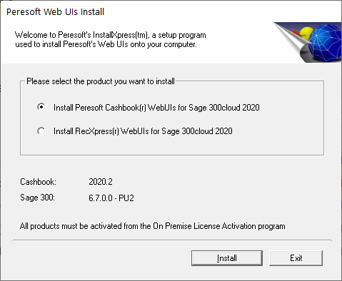
Installing Cashbook for Sage 300cloud
Install the following after installing Sage 2020 PU2:
17700 - Web UI Install Screen
Cashbook On-premise 2020.2 -17000.exe
Run the Peresoft Web UI install - 17700.exe
Install Cashbook WebUIs for Sage 300cloud
Install RecXpress Web UIs if necessary
EFTXpress is integrated into Cashbook installation

Slide 6
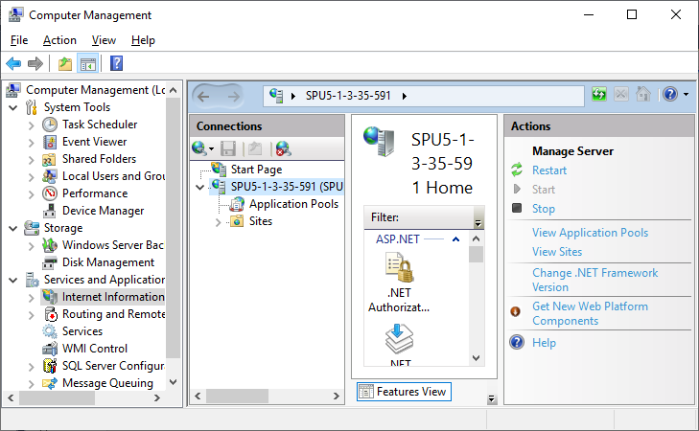
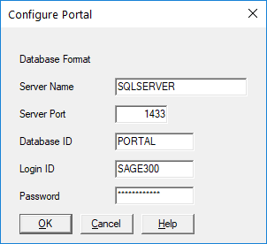
Completing Installation
Once the installation is completed you must:
Restart Microsoft Internet Information Services (IIS)
Re-Run the Portal database configuration from Sage 300 Database Setup

Slide 7
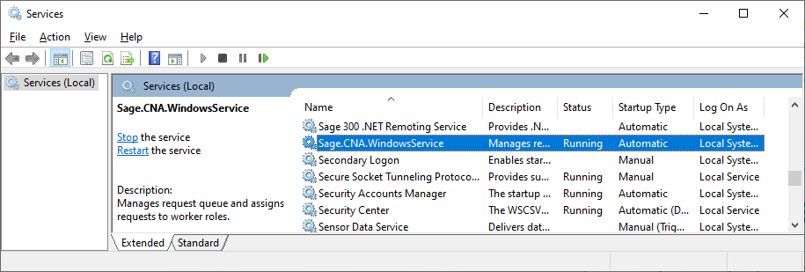
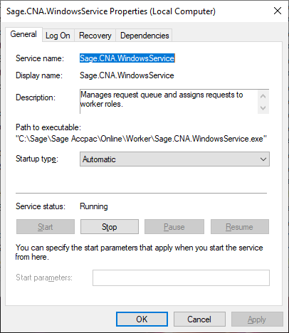
Make Sure the Sage.CNA.WindowsService has been started
The Sage.CNA.WindowsService is used to run all the Sage View processing functions across the web

Slide 8
Peresoft’s products will now display in your Sage 300cloud Web menu

Slide 9
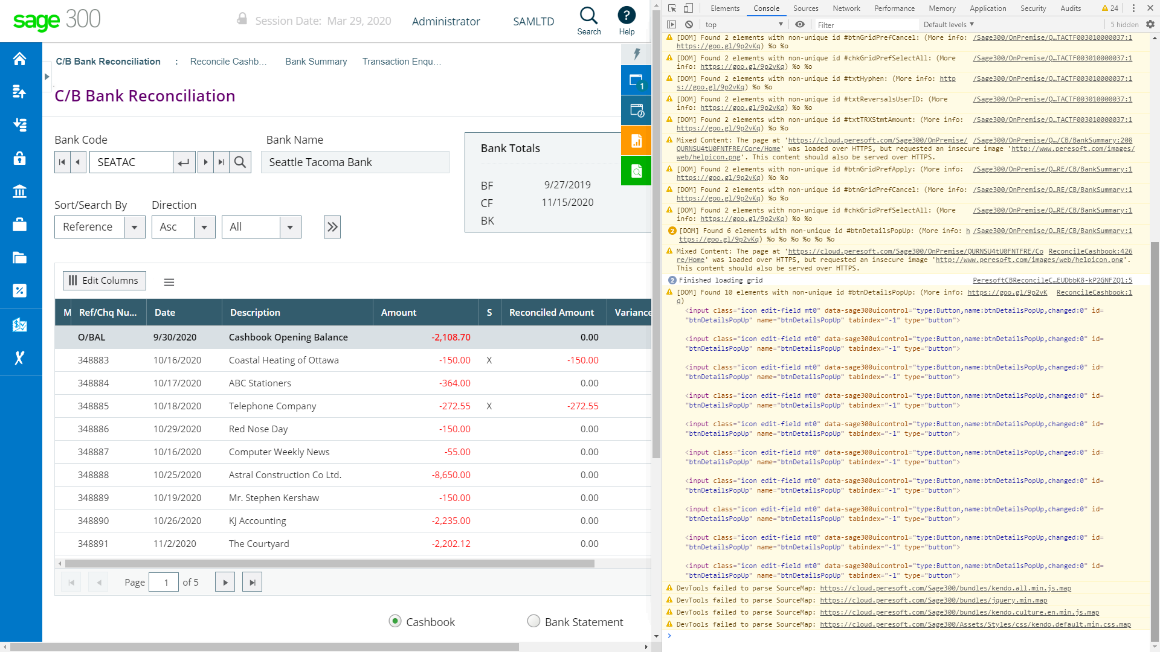
Debugging and Problem Solving
Use Inspect to Identify Issues
If the web screen stops working, right click, select inspect, select the Console tab and see if you can pinpoint the error.

Slide 10
Debugging and Problem Solving
Log Files
You will also find a log file under:
  [program dir]\online\web\logs
  [program dir]\online\worker\logs

Slide 11
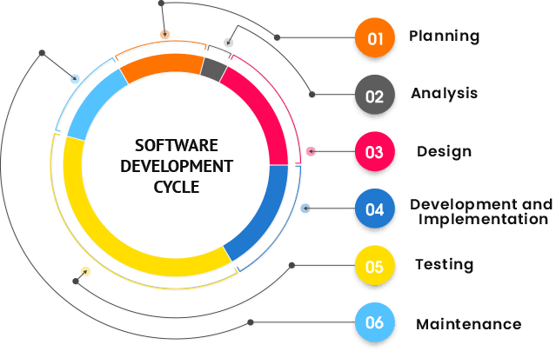
Sage SDK Development
All Peresoft’s products have been developed using Java Script, C# and Razor Views (which are compiled).
Features available to the Sage 300 products are also available to Peresoft products. E.g. Screen Customization, Web Services, etc.
View architecture, developed and debugged through the years using C, is used throughout Peresoft’s products.

Slide 12
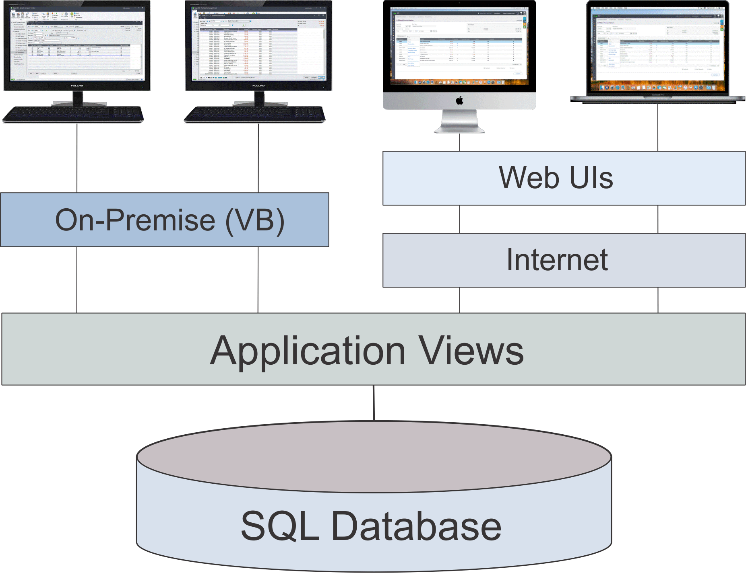
Database Updates Via the Views
Data Integrity is secured because data updates are always done via views

Slide 13
Advantages Using Views
All database updates are processed via the views
Views were developed in C, a language that never ages
Over the years the views have been debugged
Views don’t change except when new fields are added
Overhead on the server is minimal
Processes, e.g. posting, are very efficient

Slide 14
Advantages Using Web UIs
Easy to install
Only one installation for the client
No workstation setup
Use a browser from any computer, laptop, tablet, smartphone, etc.
Perfect fit for the future
True 3 tier architecture

Slide 15
Tips and Advice For Entering Data, etc.
Do not create batches that are too large.
When entering many detail lines, save regularly. For example, if you are entering 20 detail lines, save after 5, 10, 15, 20. If the browser stops working or the internet disconnects you could lose anything that is not saved. This also applies to allocations and adjustments.
Make sure the user always closes the UI properly and does not just close the browser.
Get the user to log out correctly from the company.
If the user gets up from the computer tell them to logout. If they don’t the program will timeout and log them out automatically. All work will also be lost.

Slide 16

Thank You for Your Support
Web UIs
Works with sage 300cloud

