Slide 1





Web UIs
Web Screens Vs On Premise Screens
Works with sage 300cloud

Slide 2
Peresoft’s products will now display in your Sage 300cloud Web menu
Written in the Sage SDK, Peresoft new Web Uis will give you access to your Sage 300 data across the web, anywhere in the world on your laptop, iPad, iPhone, or any device that will allow you to browse the internet.

Slide 3
Feature Rich And More
Web UIs take all the features from the on-premise version in addition to adding new search features to improve the users’ experience and efficiency

Slide 4
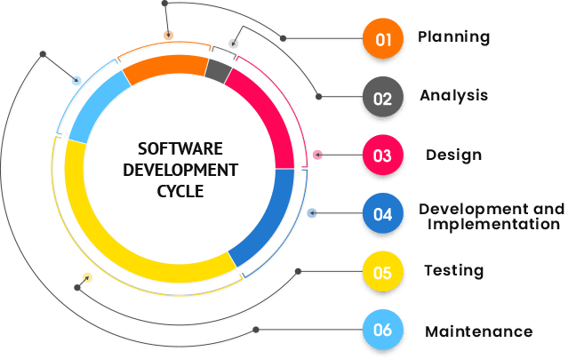
Sage SDK Development
All Peresoft’s products have been developed using Java Script, C# and Razor Views (which are compiled).
Features available to the Sage 300 products are also available to Peresoft products. E.g. Screen Customization, Web Services, etc.
View architecture, developed and debugged through the years using C, is used throughout Peresoft’s products.

Slide 5
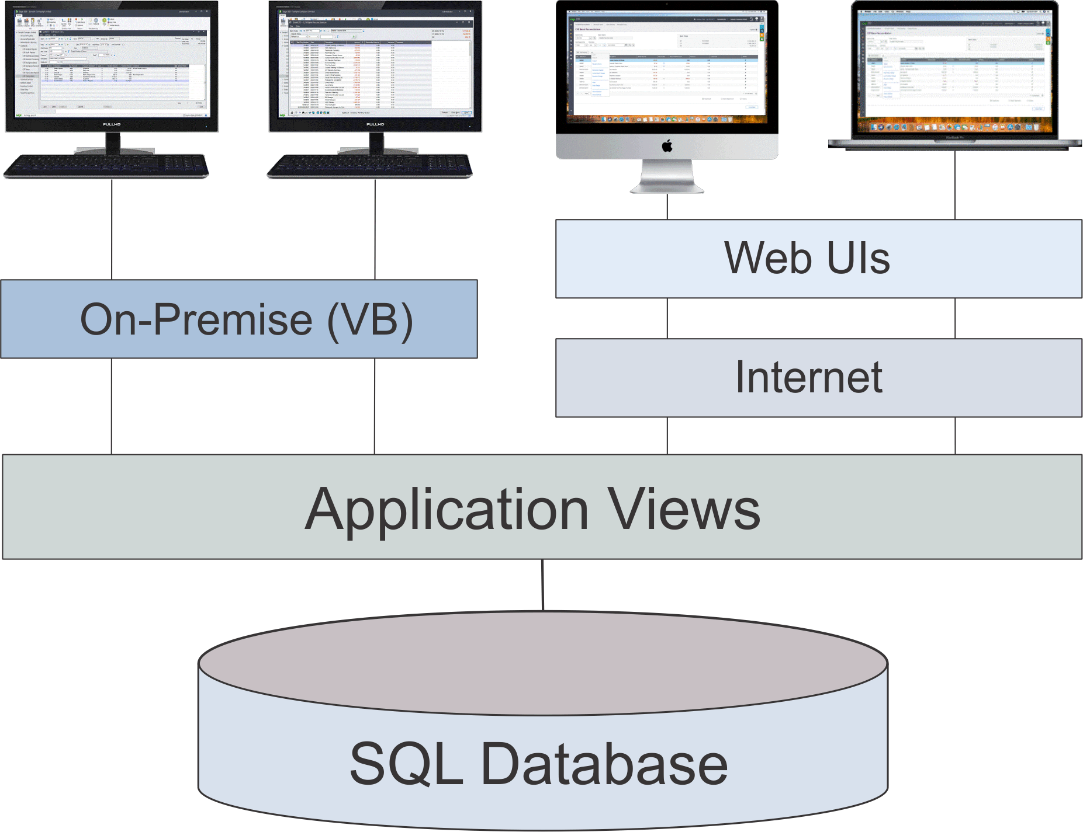
Database Updates Via the Views
Data Integrity is secured because data updates are always done via views

Slide 6
Advantages Using Views
All database updates are processed via the views
Views were developed in C, a language that never ages
Over the years the views have been debugged
Views don’t change except when new fields are added
Overhead on the server is minimal
Processes, e.g. posting, are very efficient

Slide 7
Advantages Using Web UIs
Easy to install
Only one installation for the client
No workstation setup
Use a browser from any computer, laptop, tablet, smartphone, etc.
Perfect fit for the future
True 3 tier architecture

Slide 9
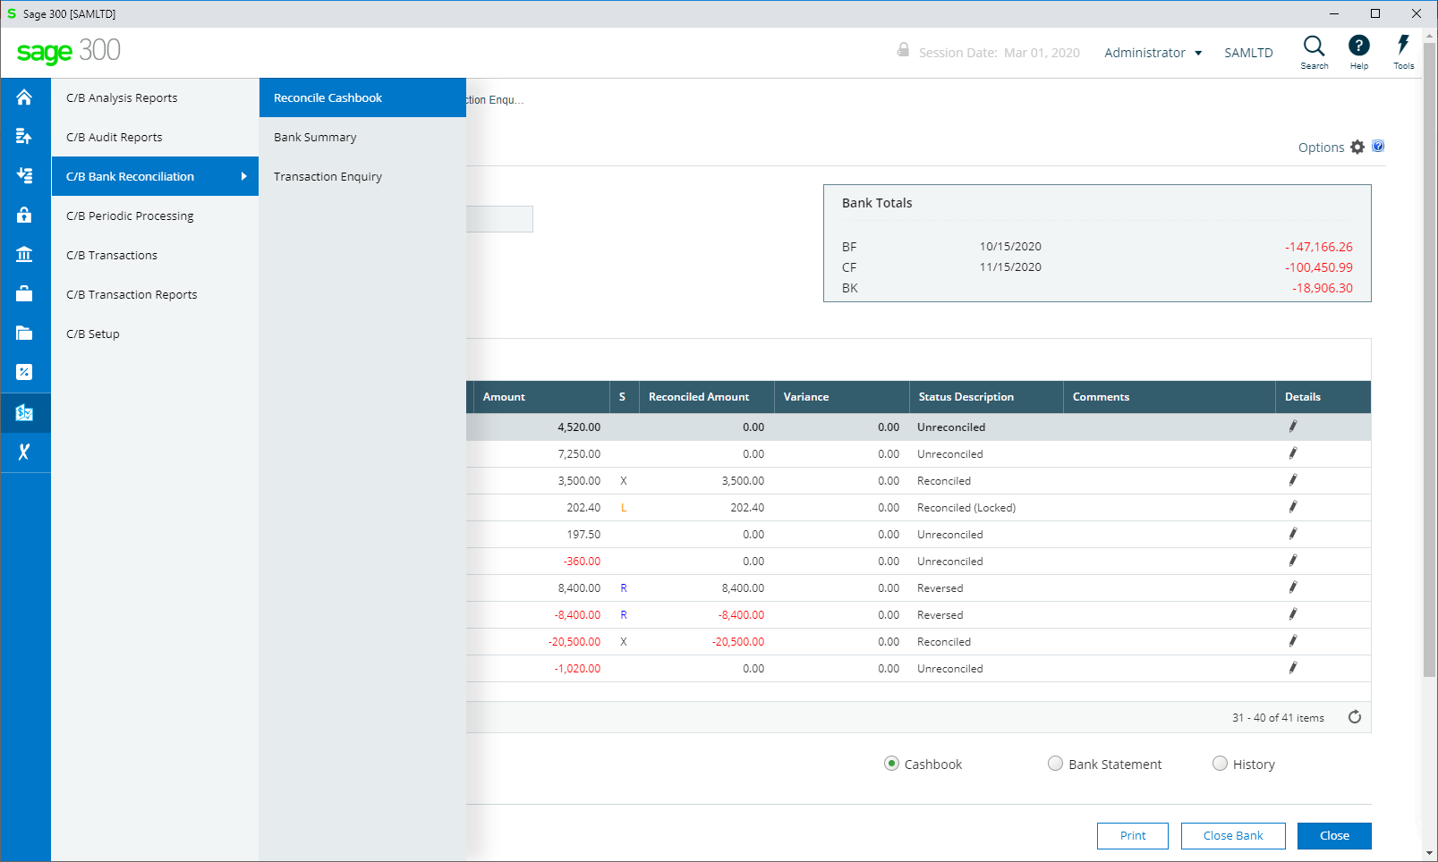
Peresoft’s Products In Sage 300cloud Web menu

Slide 10
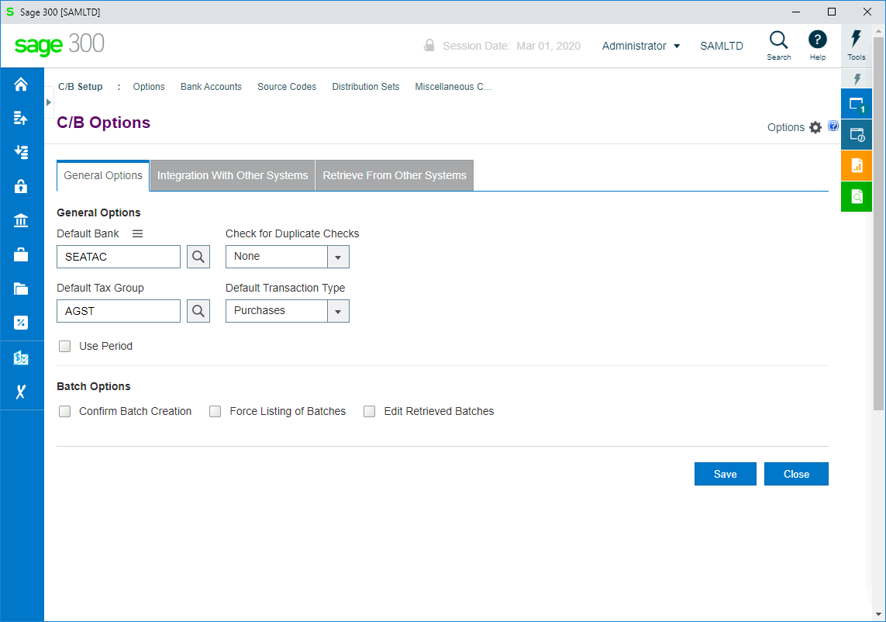

Slide 11
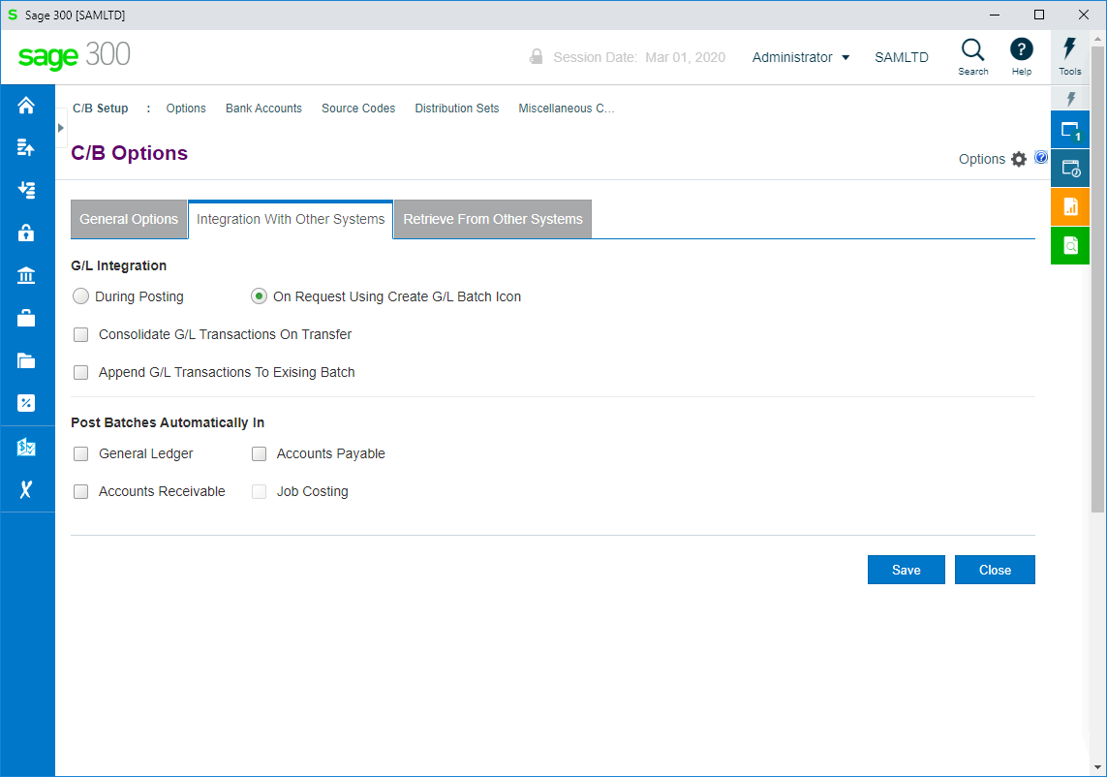

Slide 12
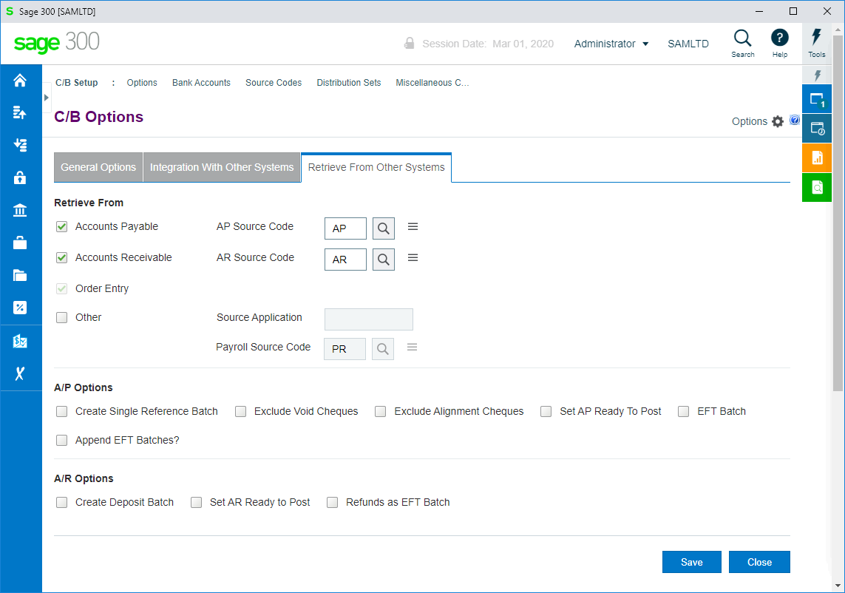

Slide 13
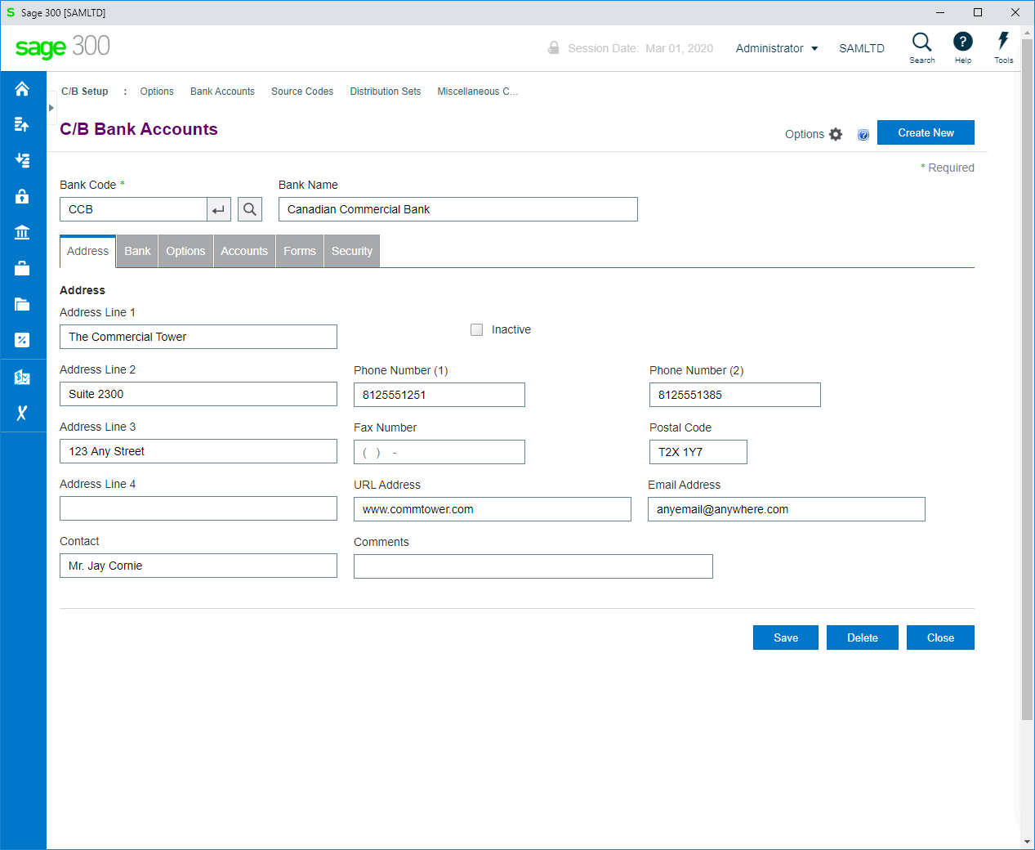

Slide 14
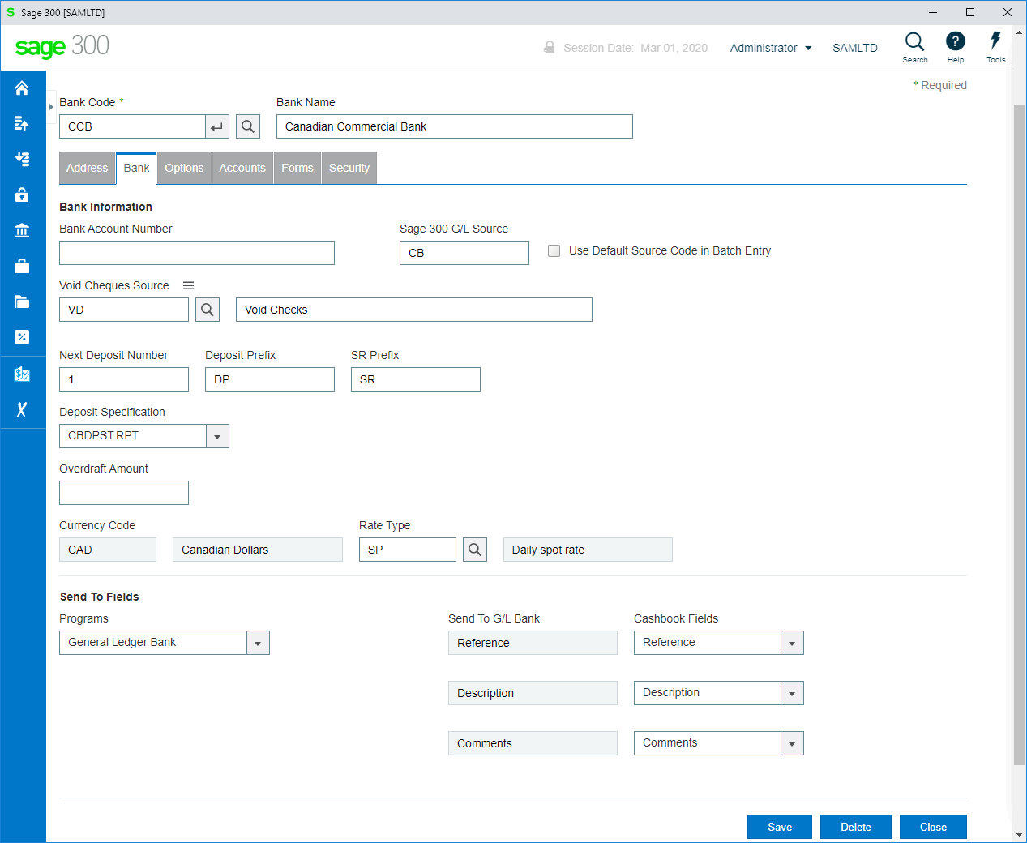

Slide 15
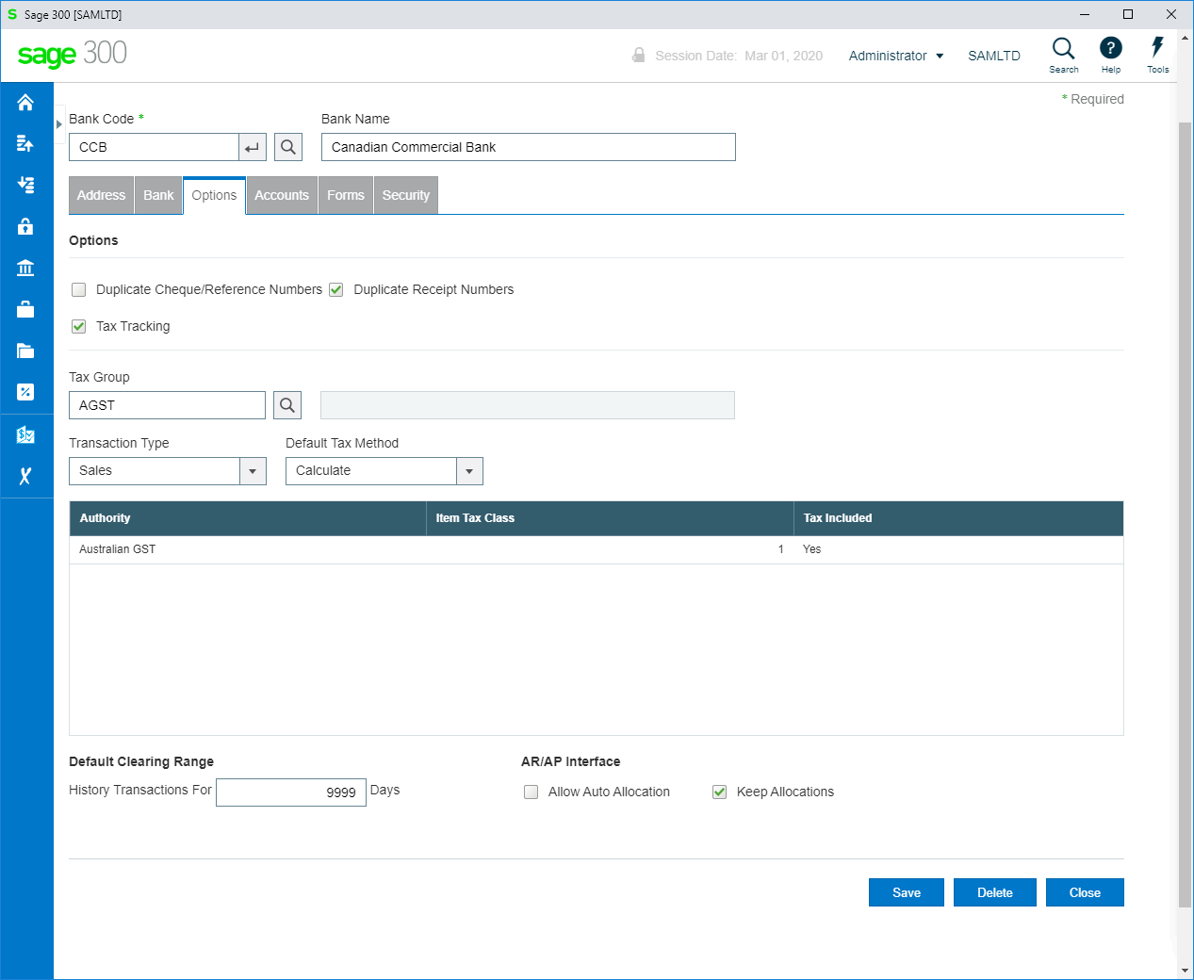

Slide 16
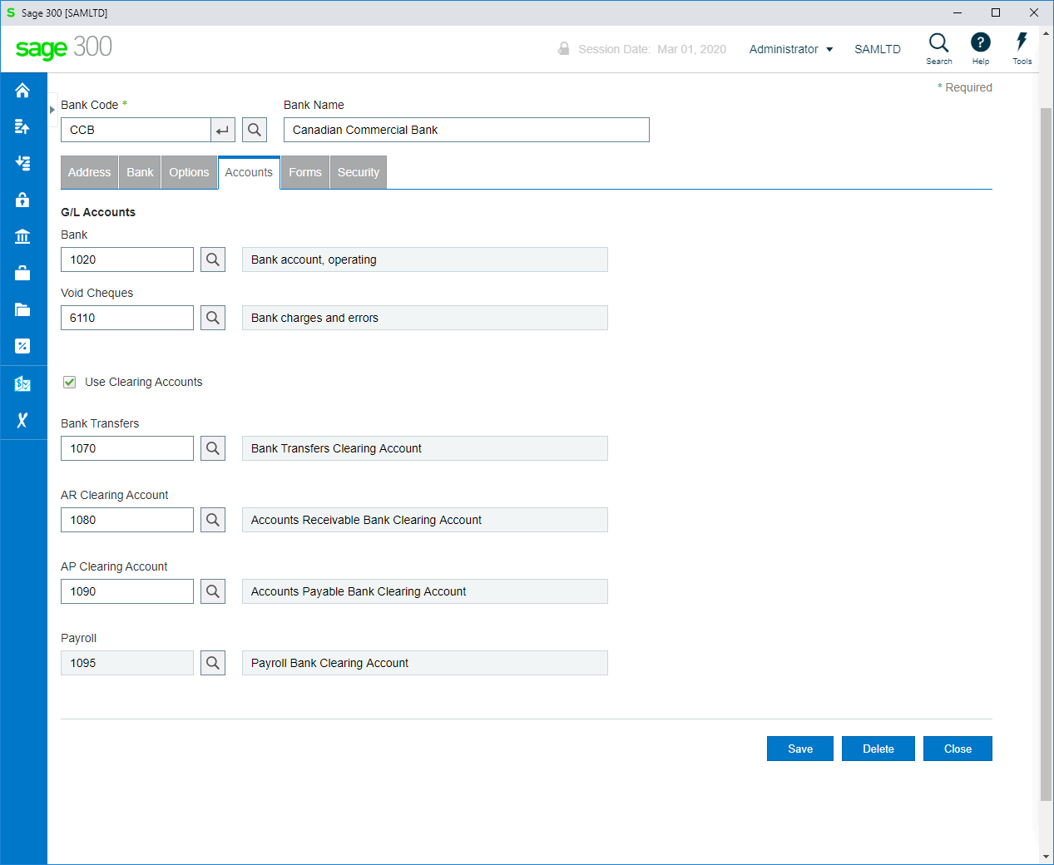

Slide 17
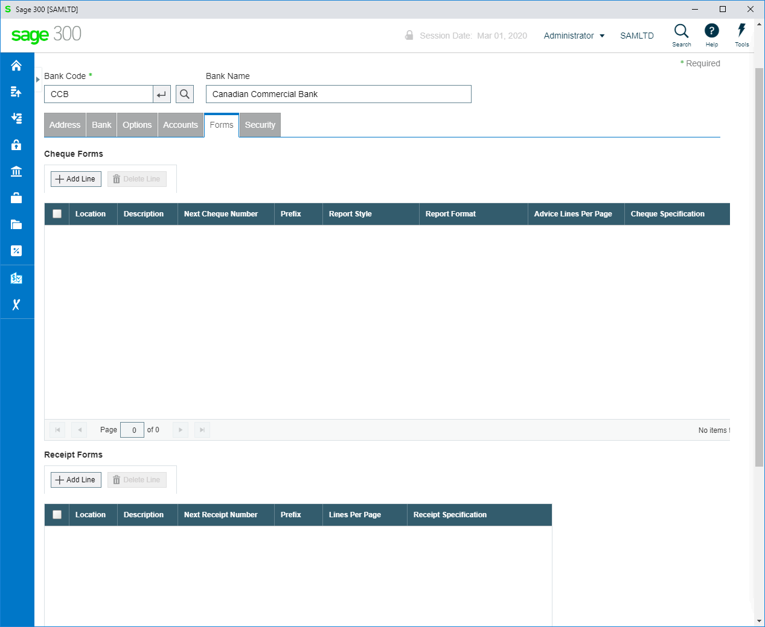

Slide 18
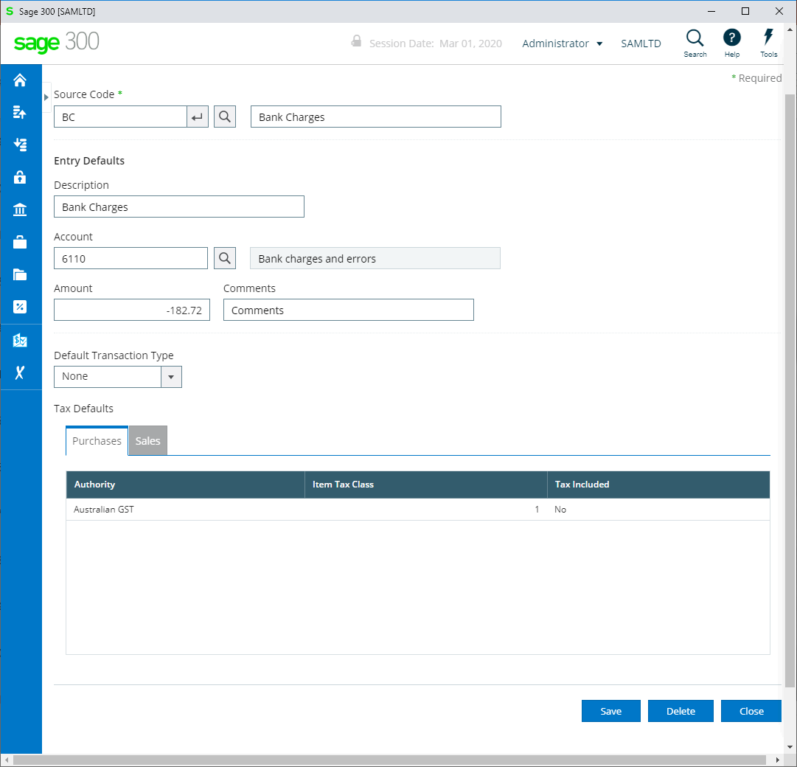

Slide 19
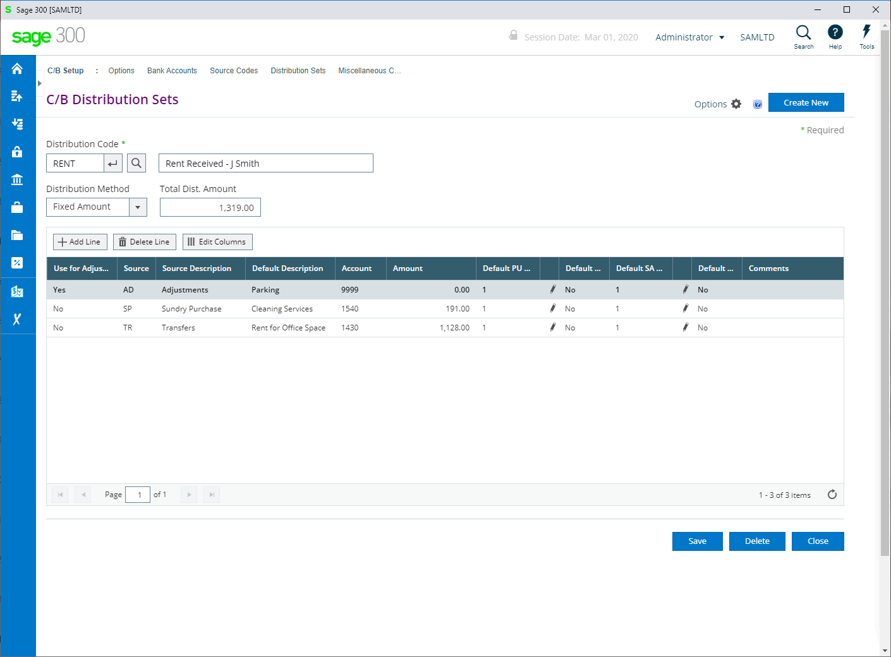

Slide 20
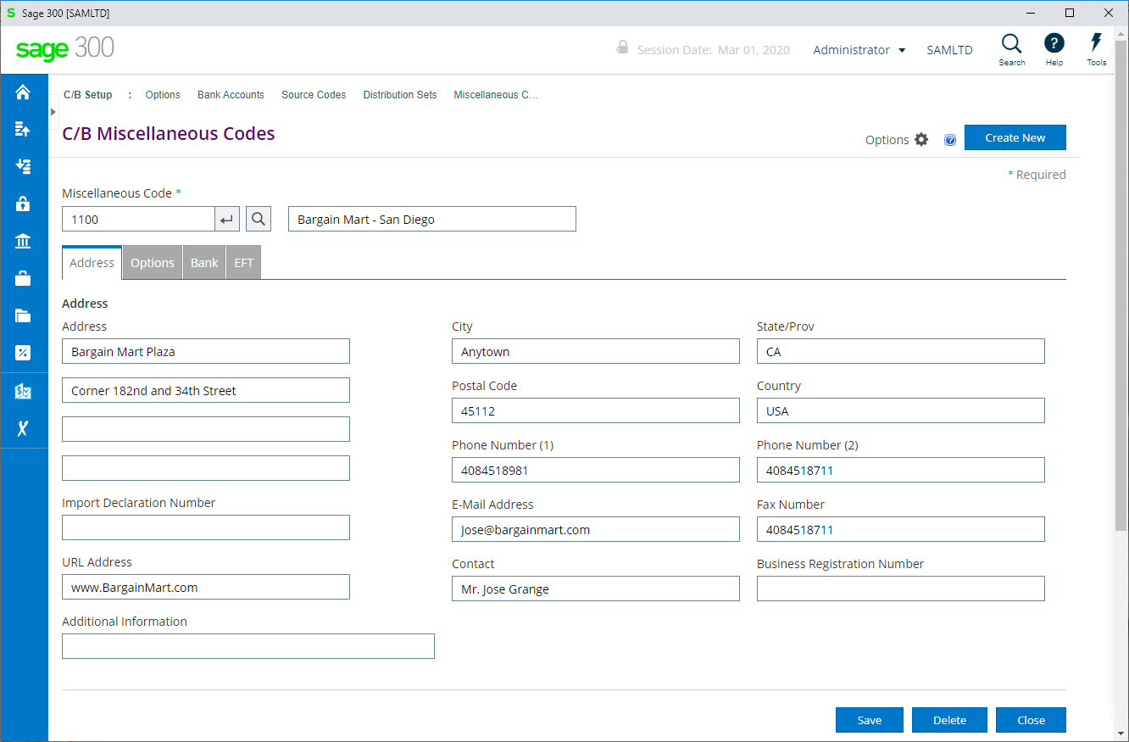

Slide 21

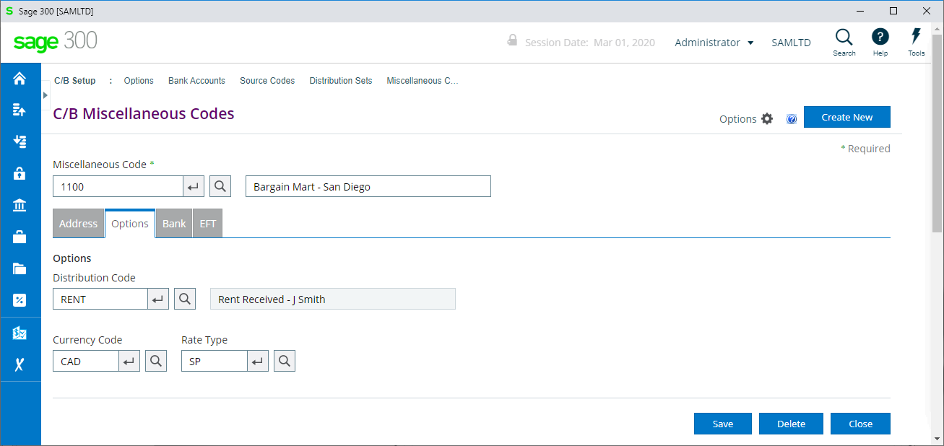

Slide 22
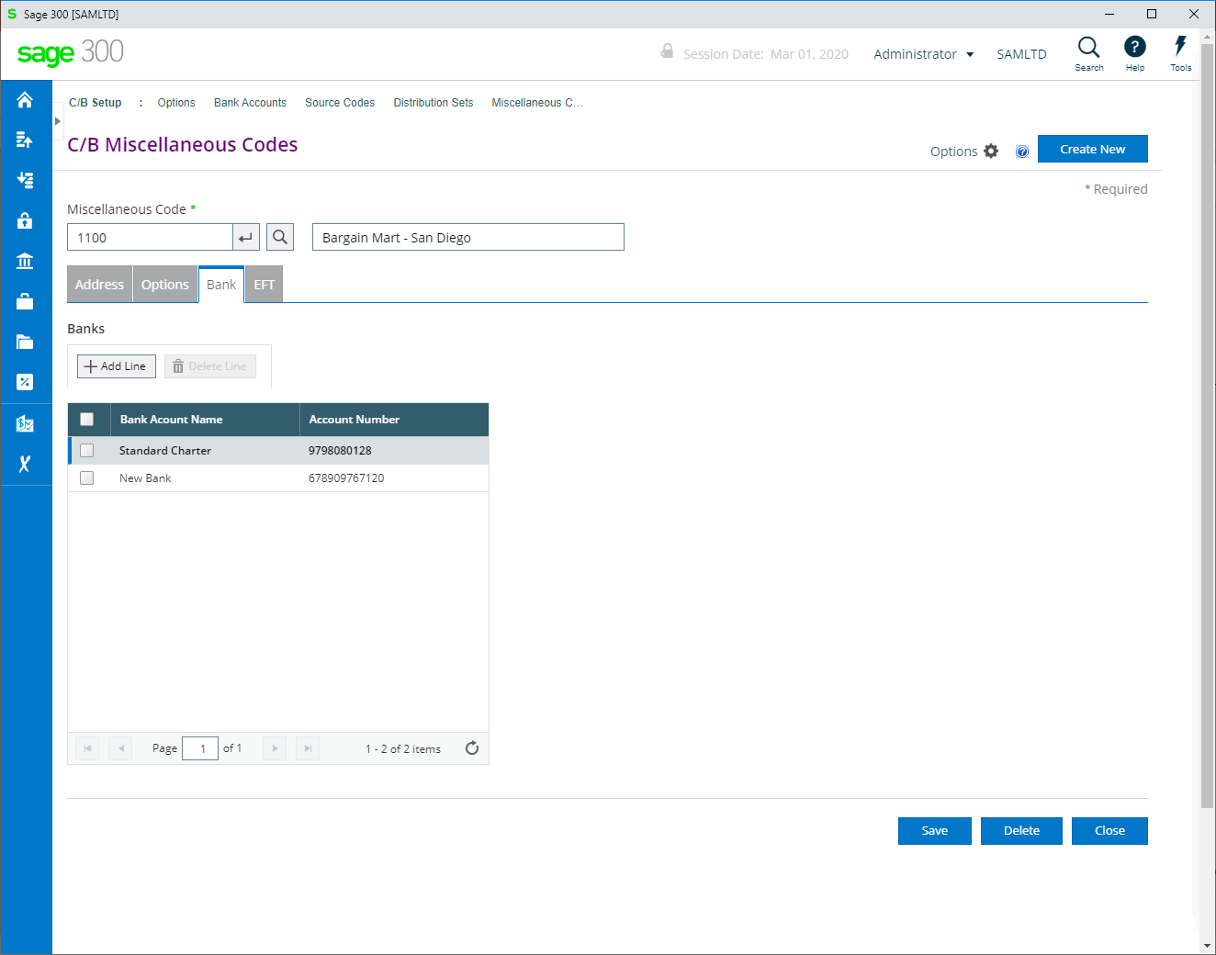

Slide 23
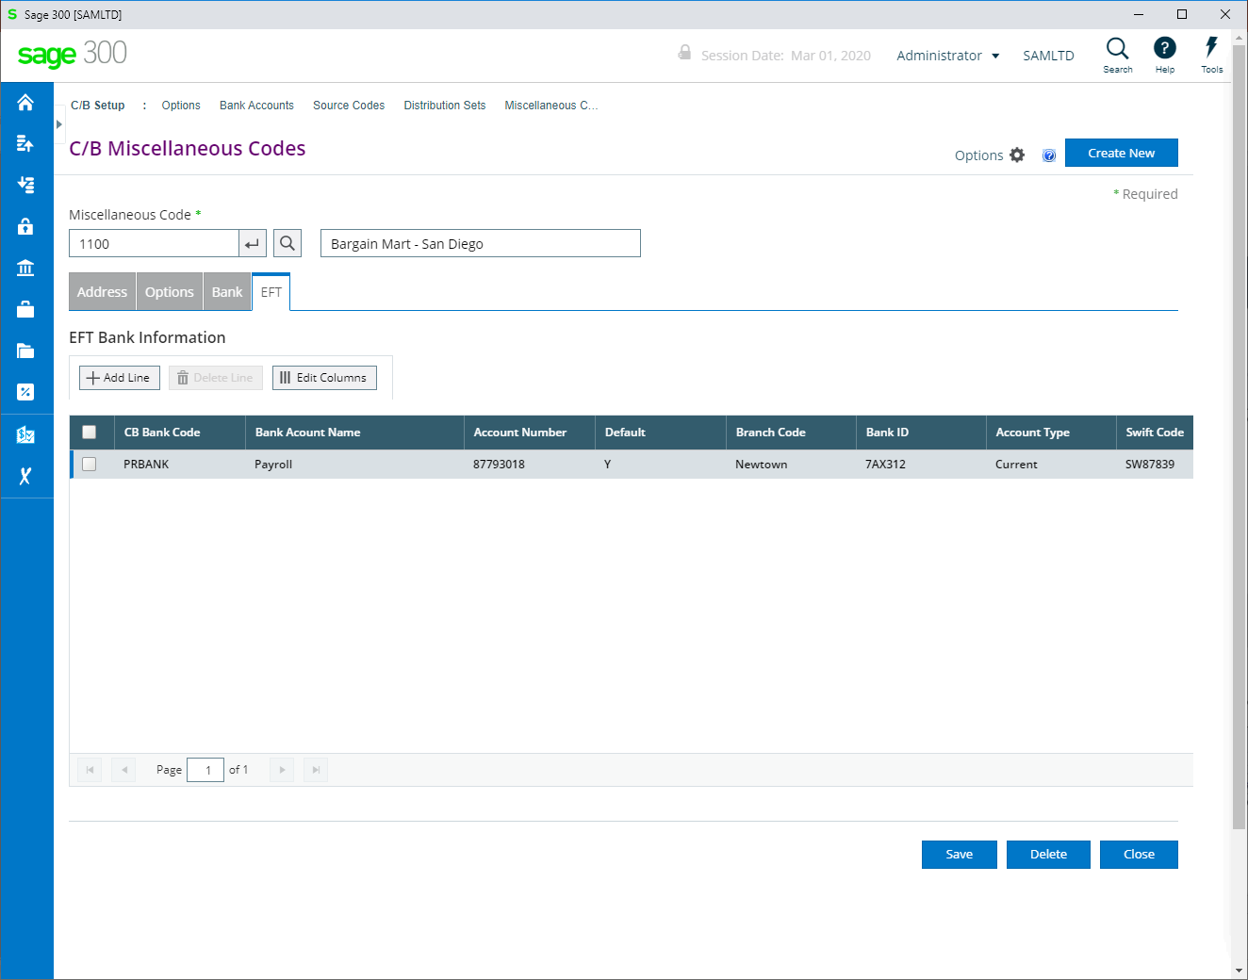

Slide 24
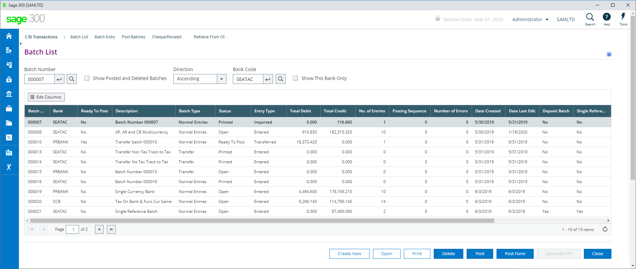

Slide 25
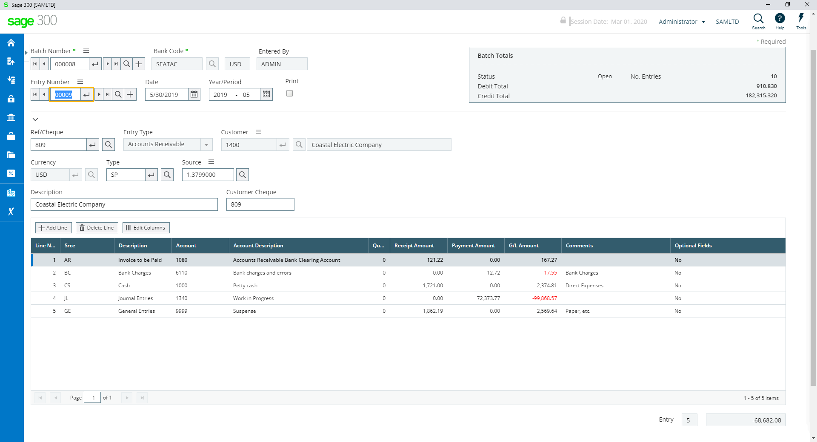
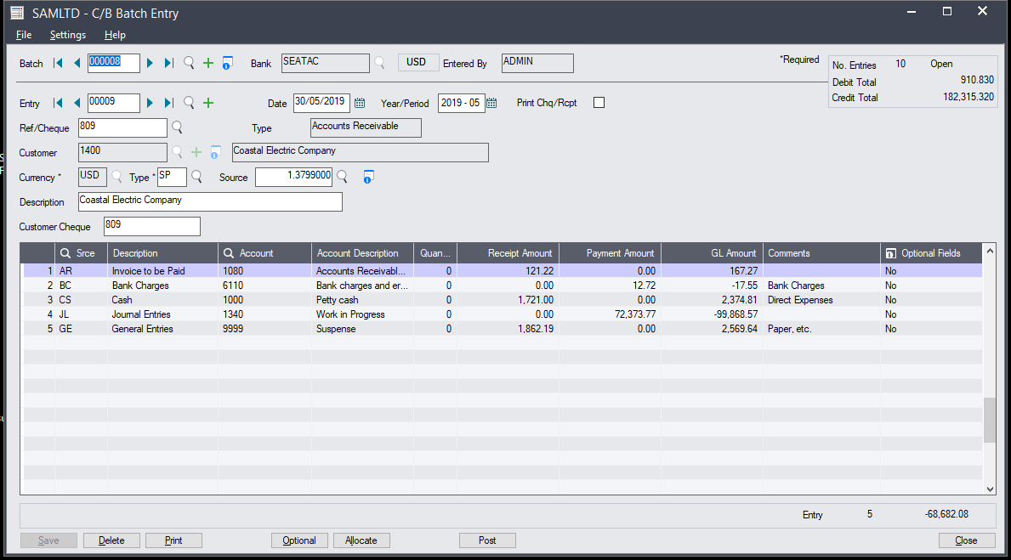

Slide 26
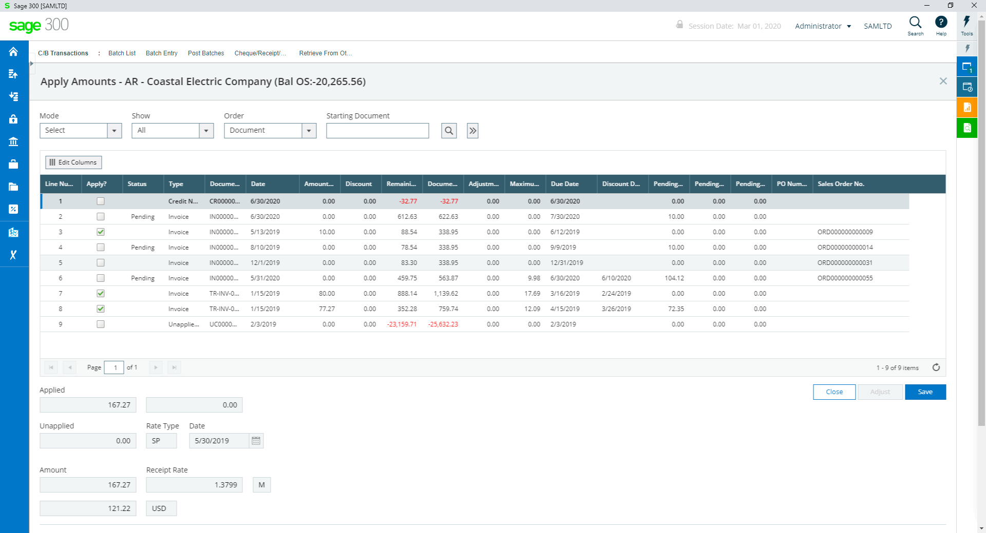
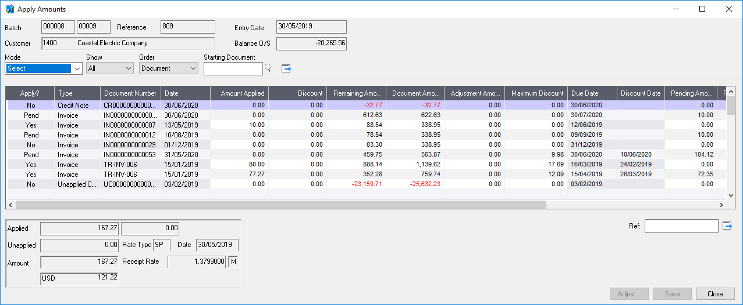

Slide 27
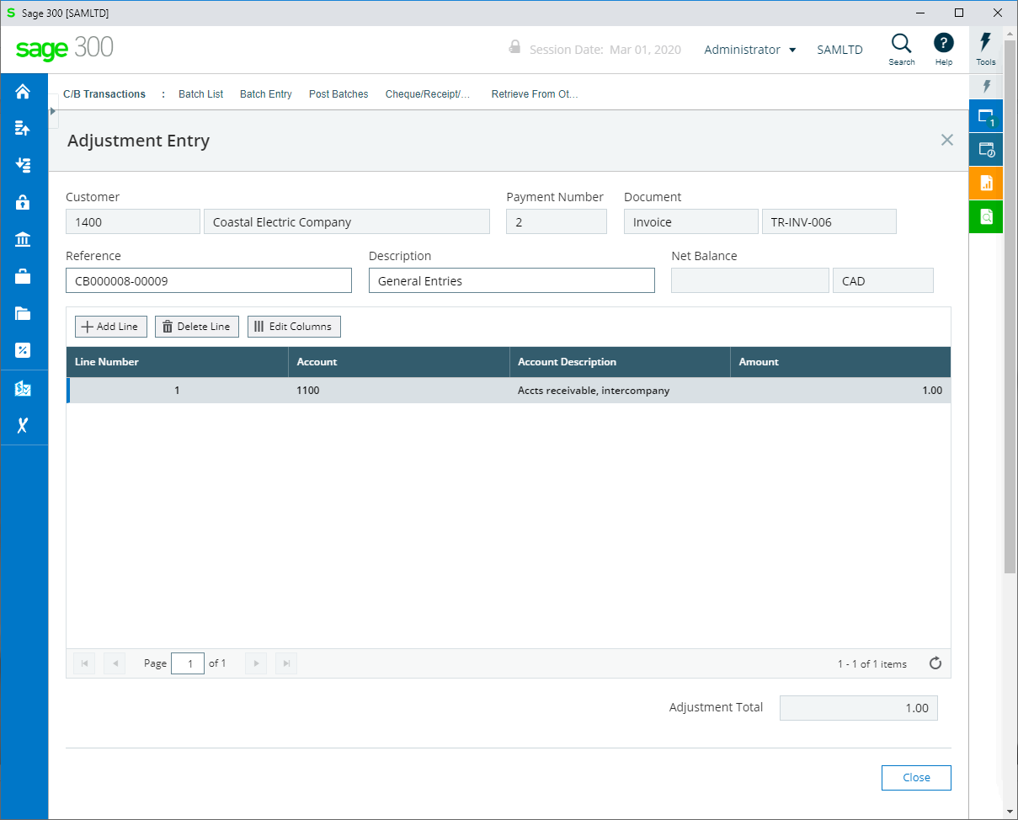
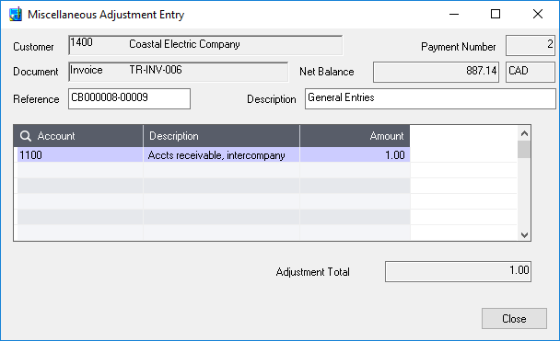

Slide 28
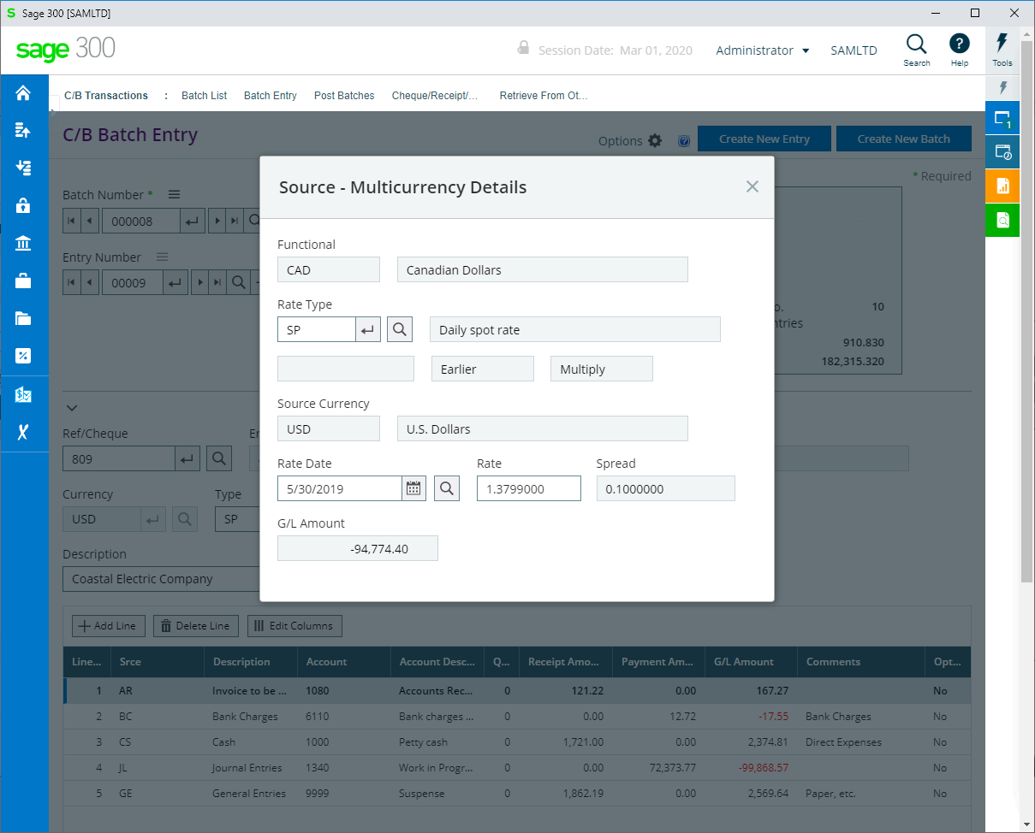
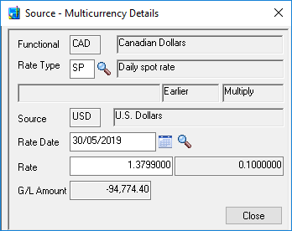

Slide 29
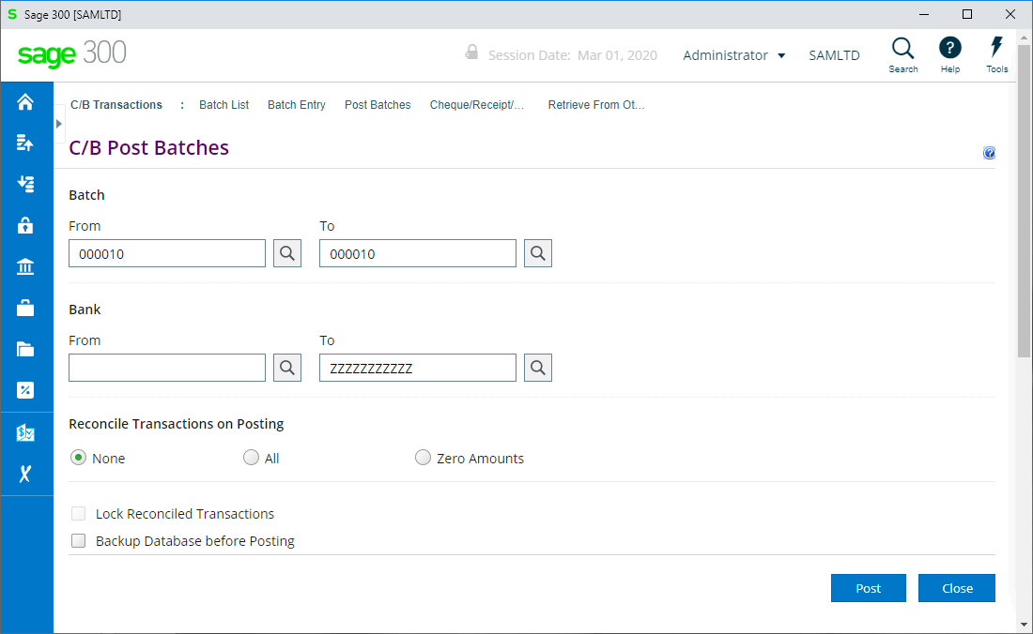

Slide 30
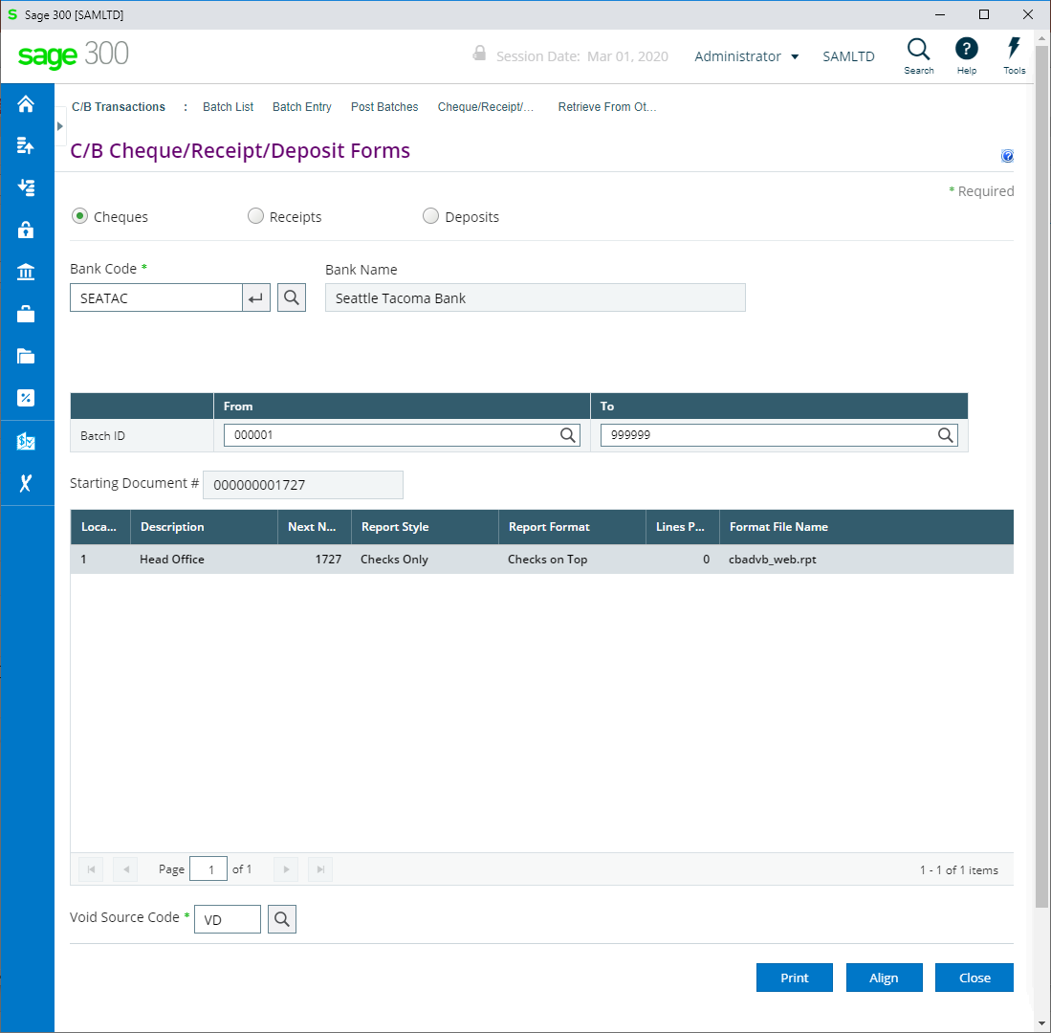

Slide 31
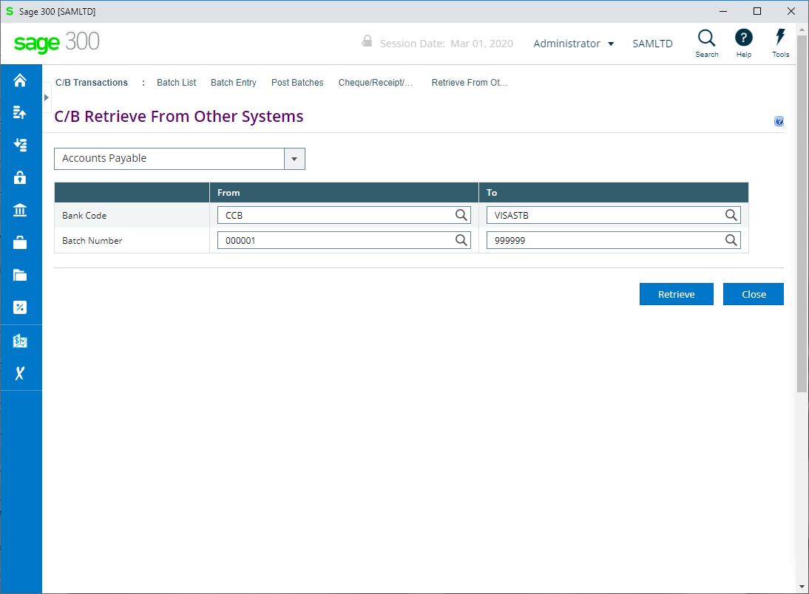

Slide 32
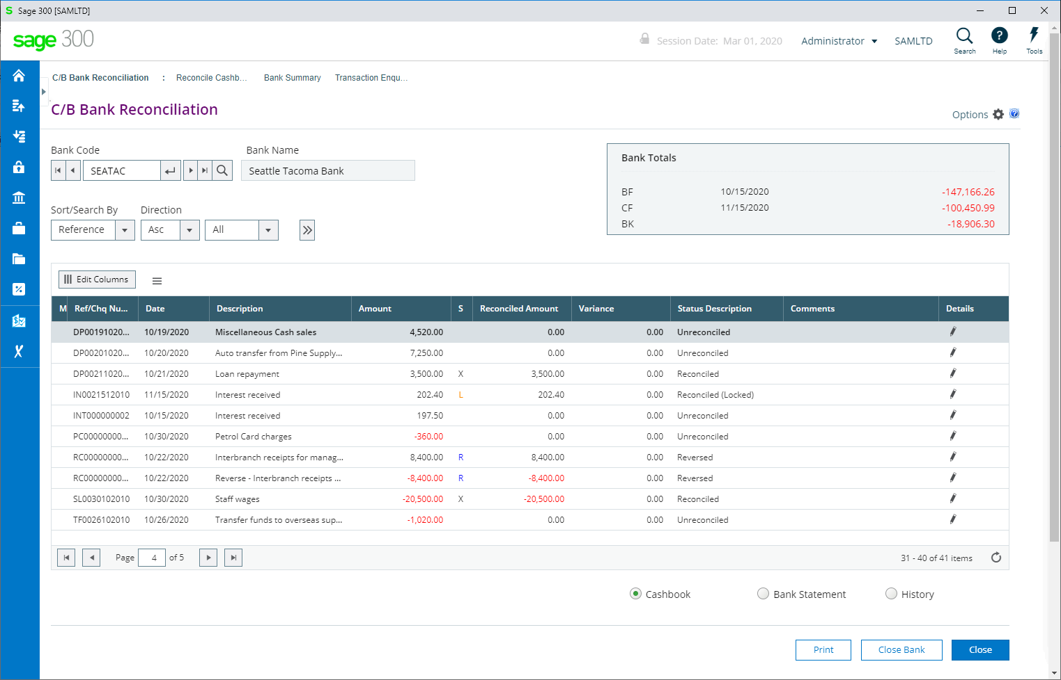

Slide 33
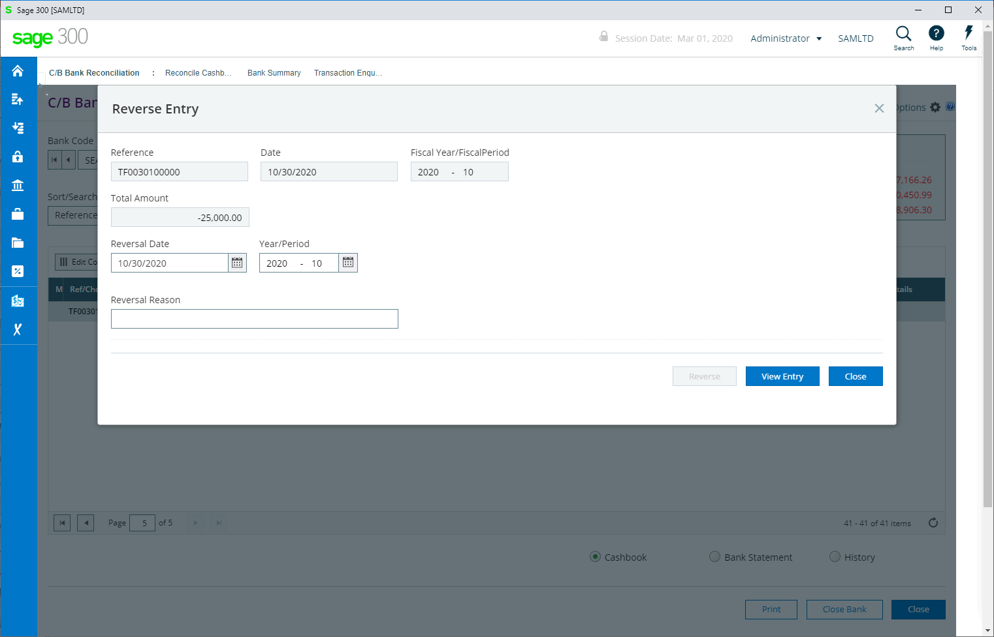
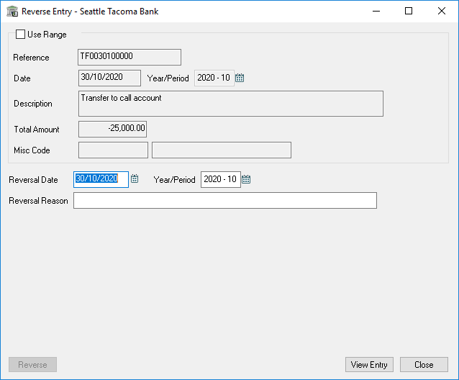

Slide 34
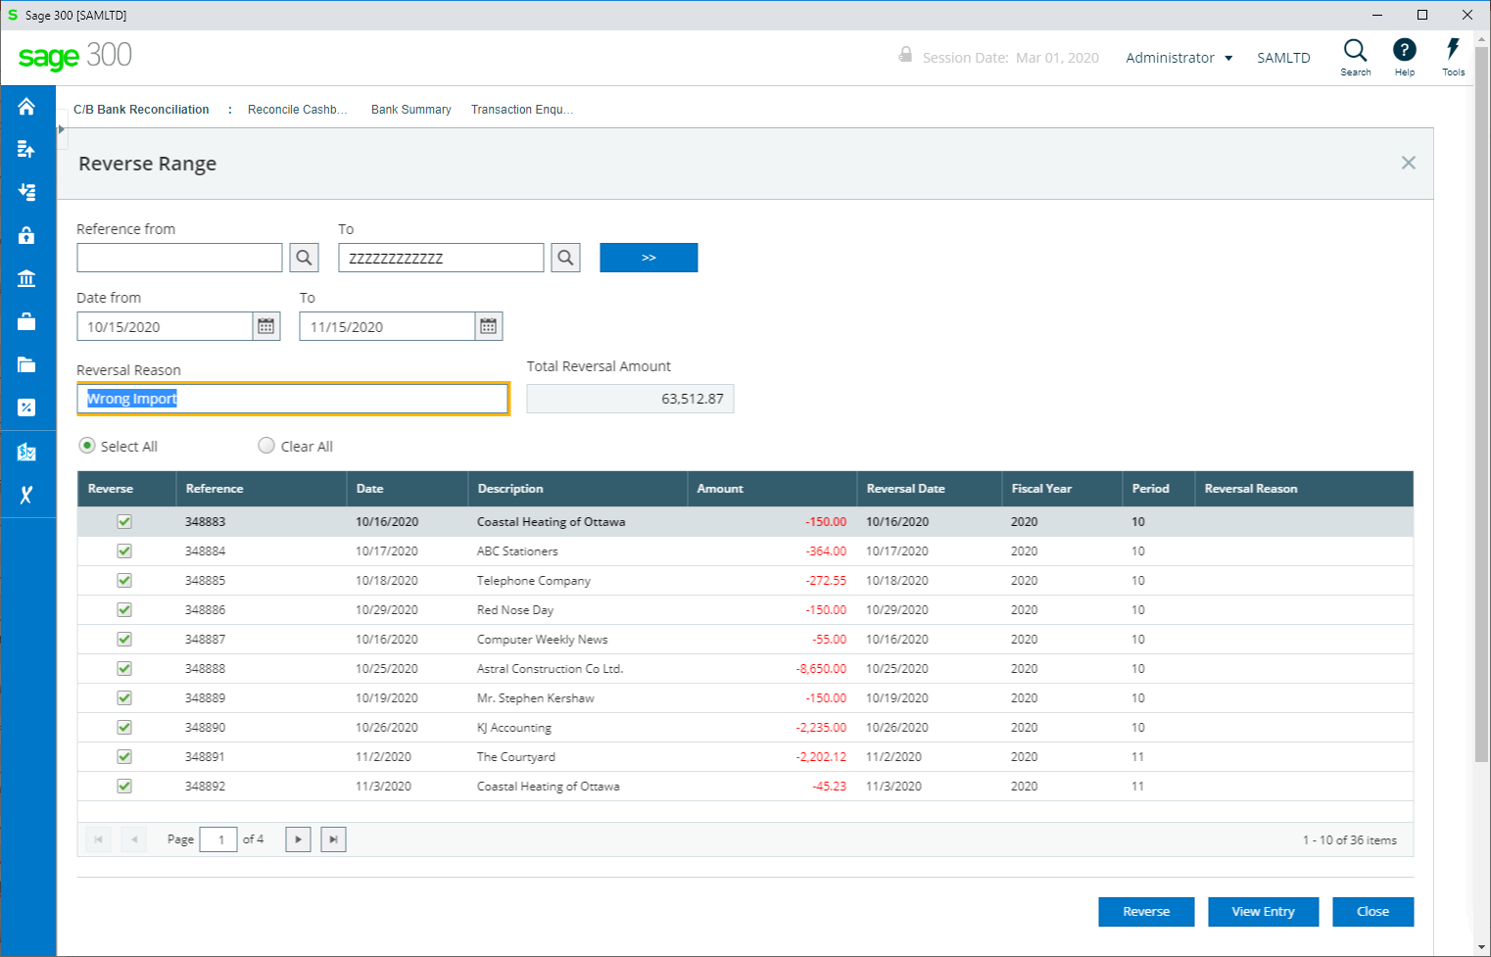
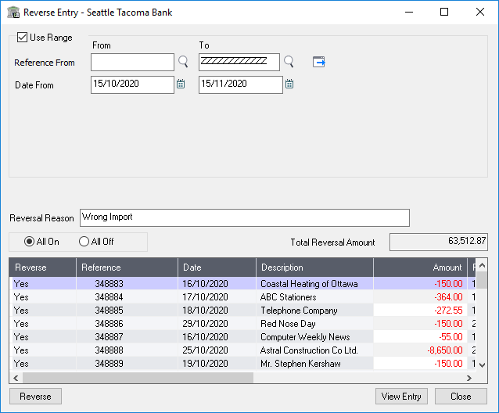

Slide 35
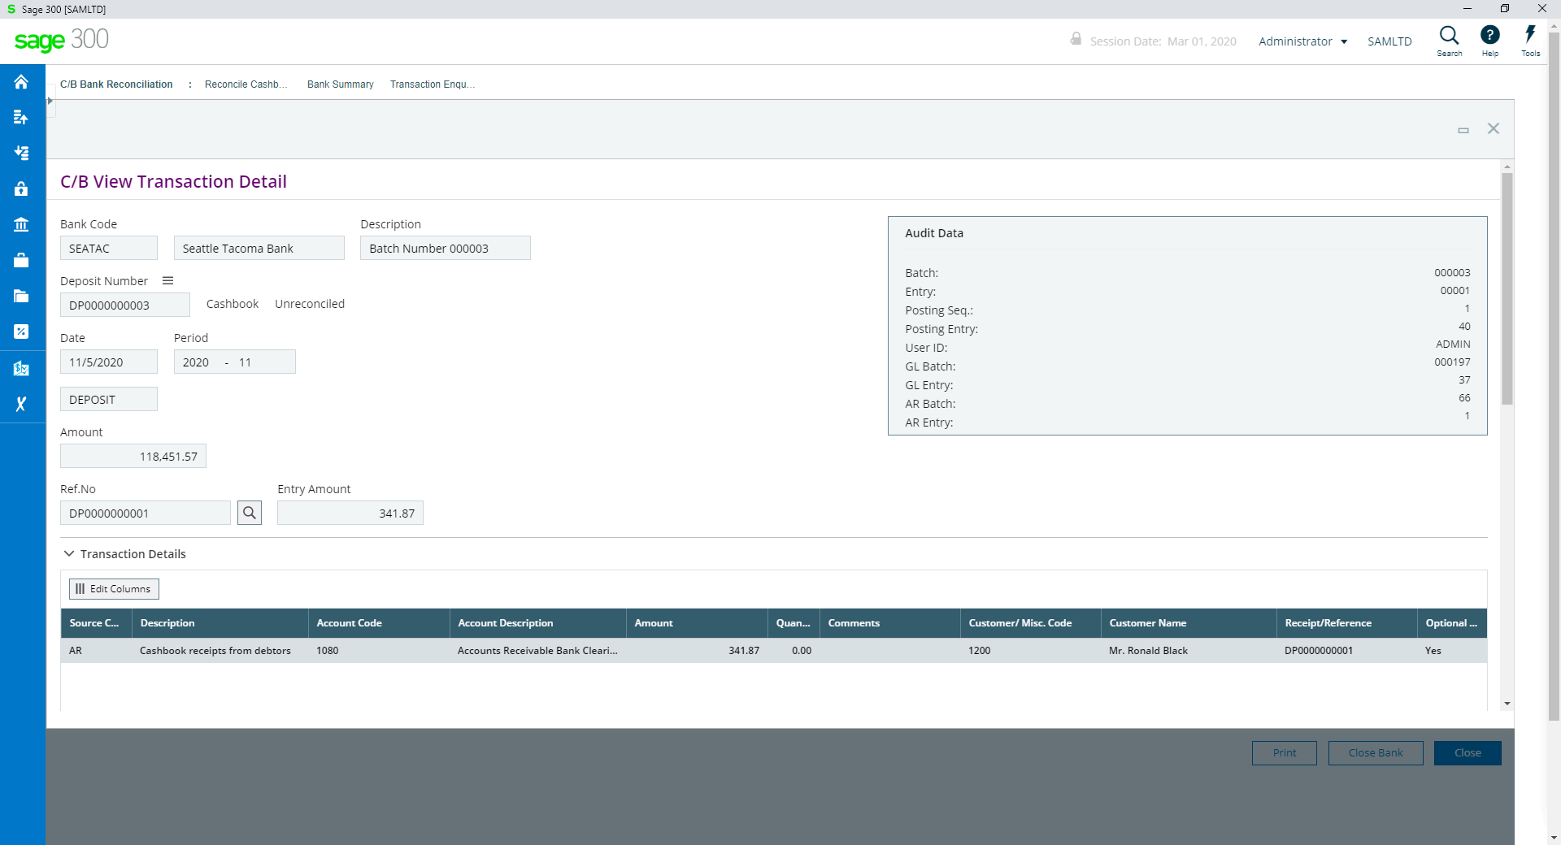

Slide 36
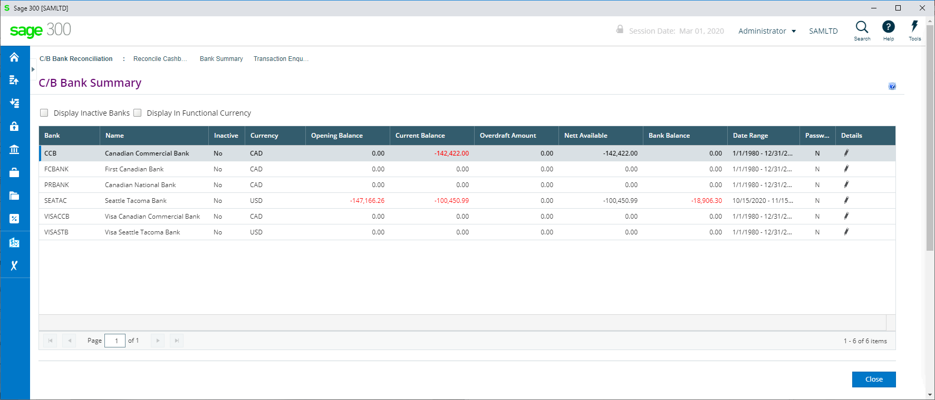

Slide 37
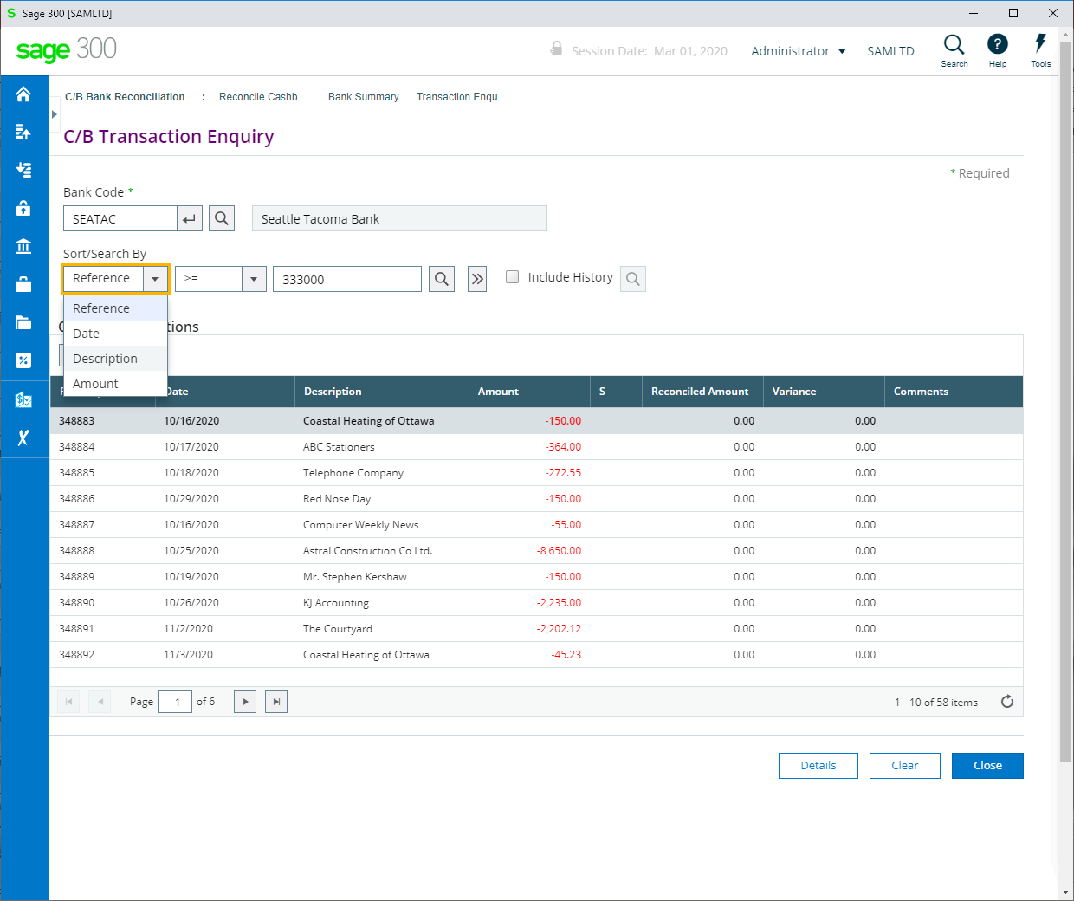

Slide 38
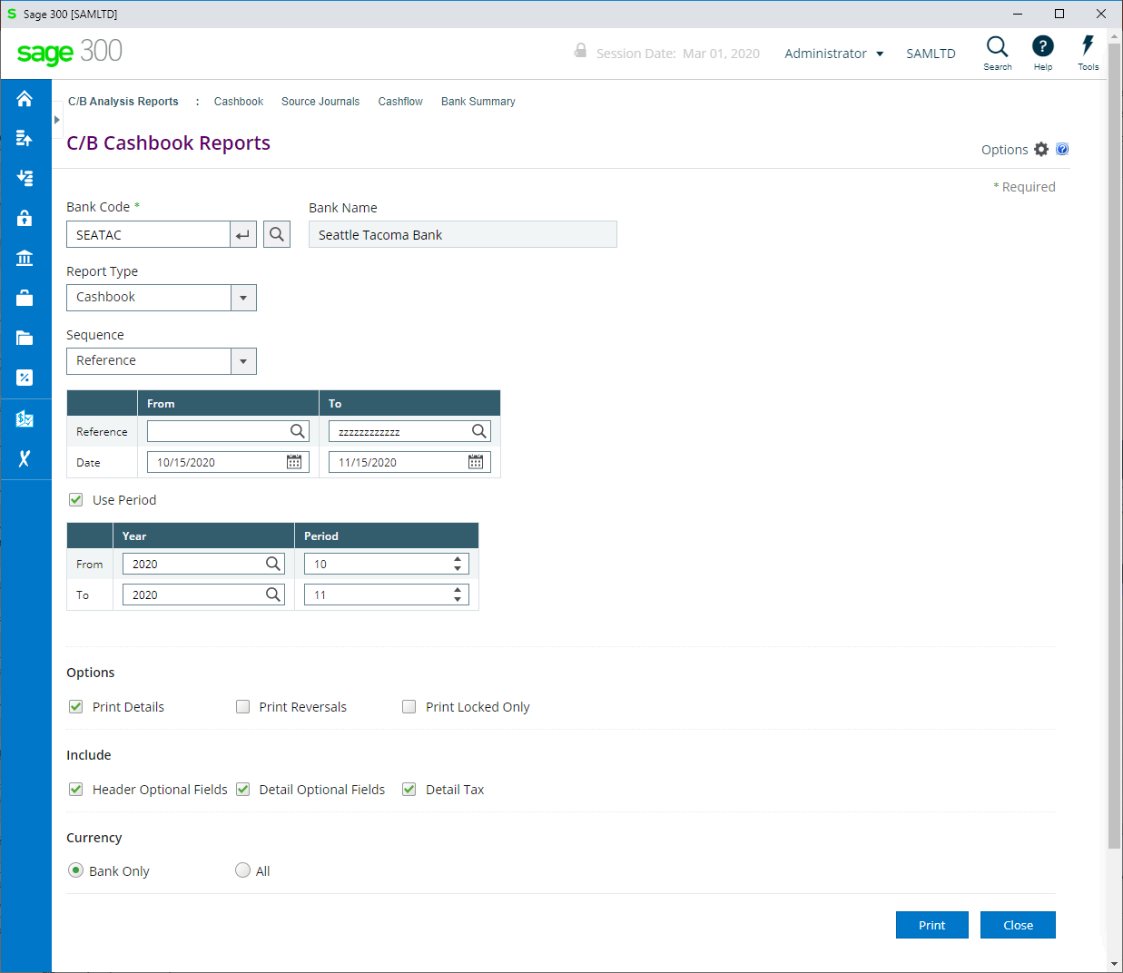

Slide 39
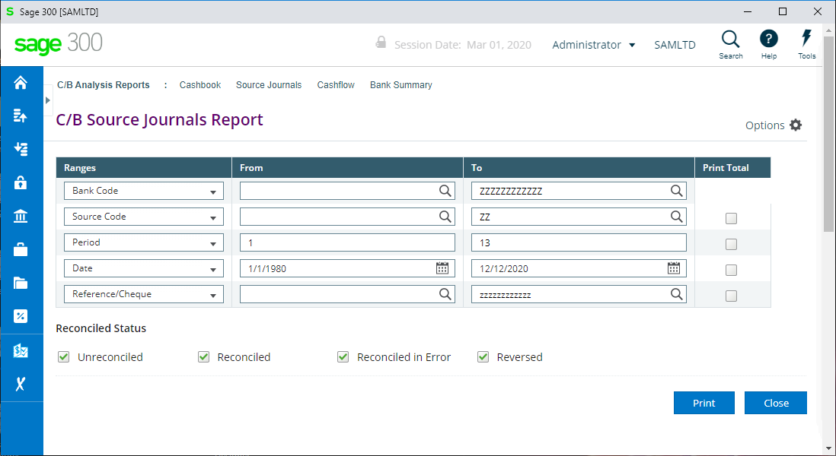

Slide 40
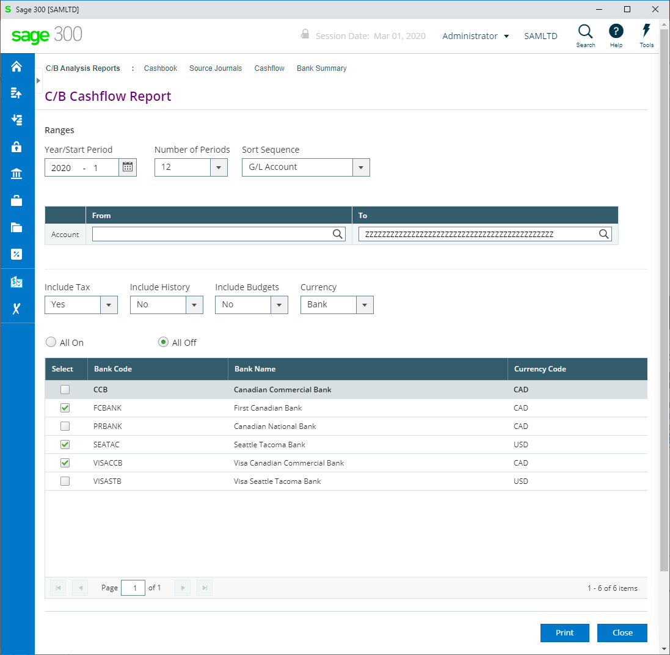

Slide 41
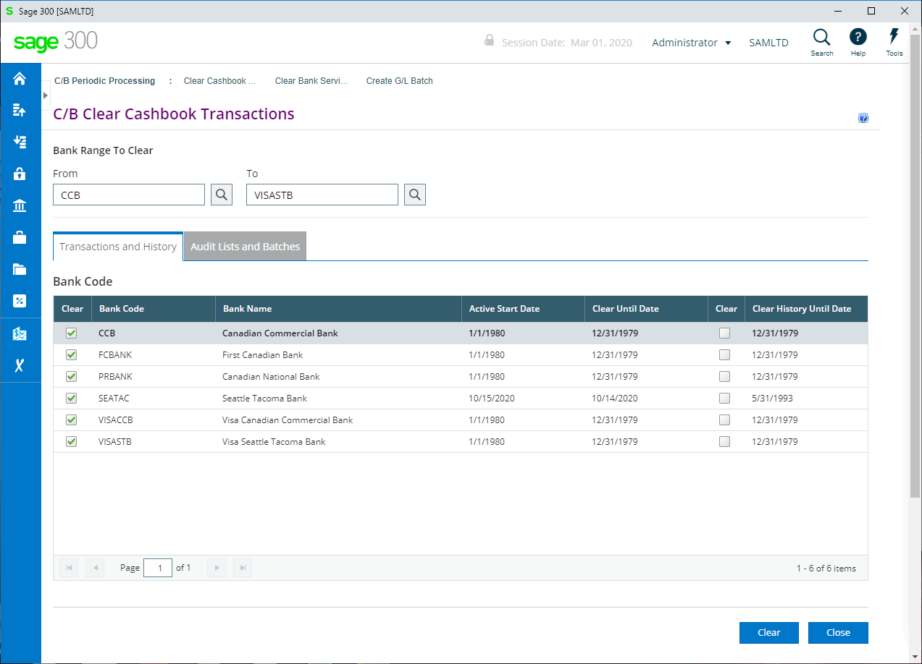

Slide 42
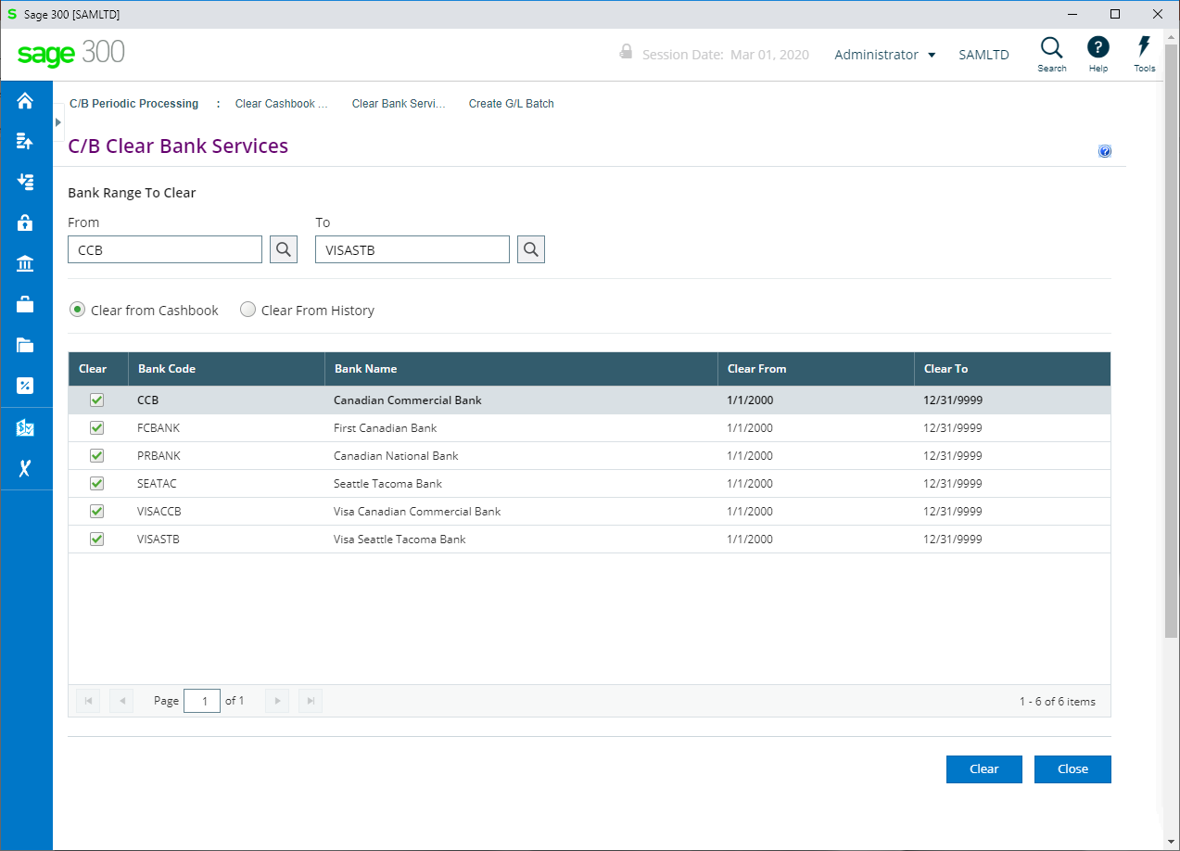

Slide 43
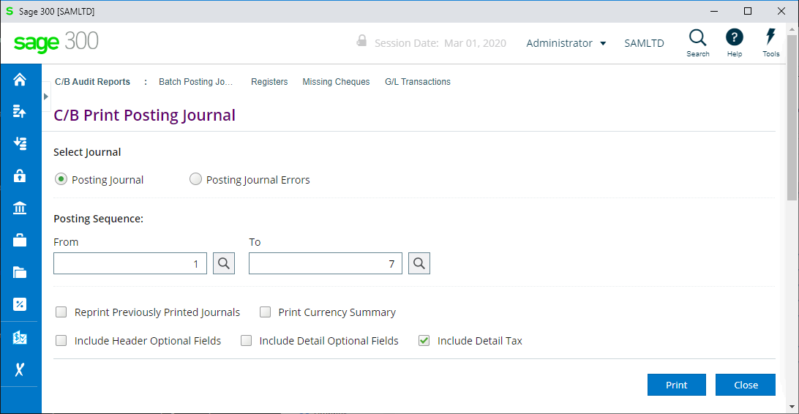

Slide 44
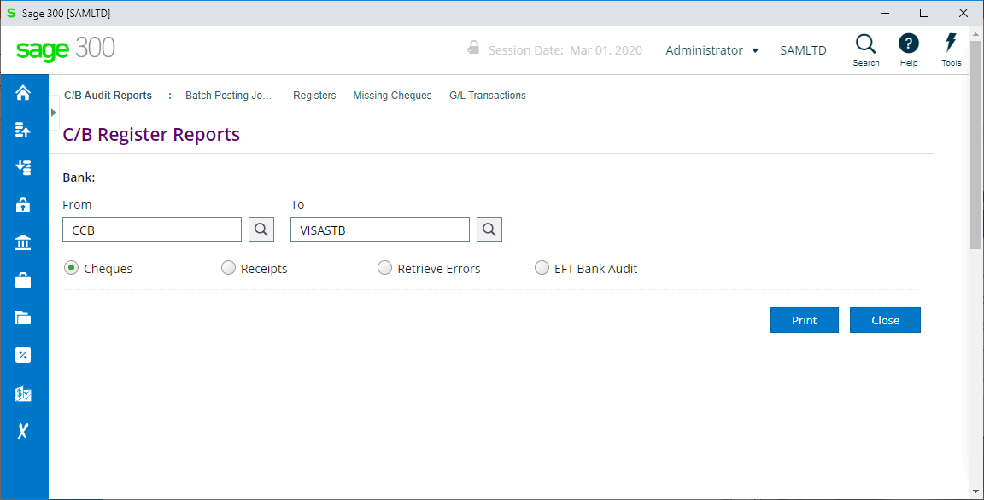
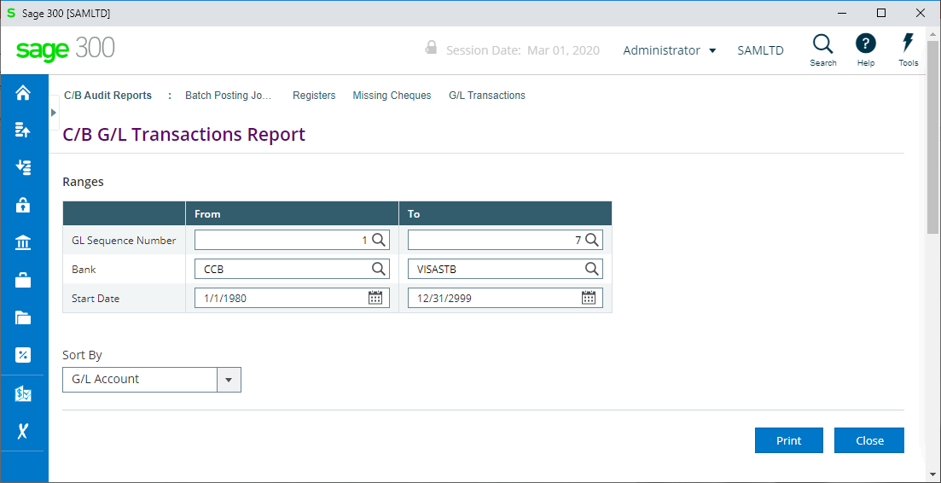
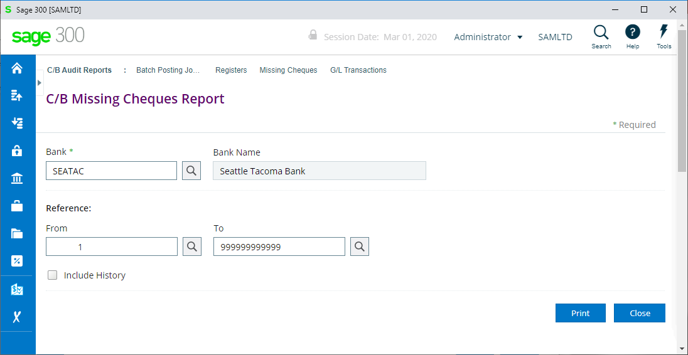

Slide 47
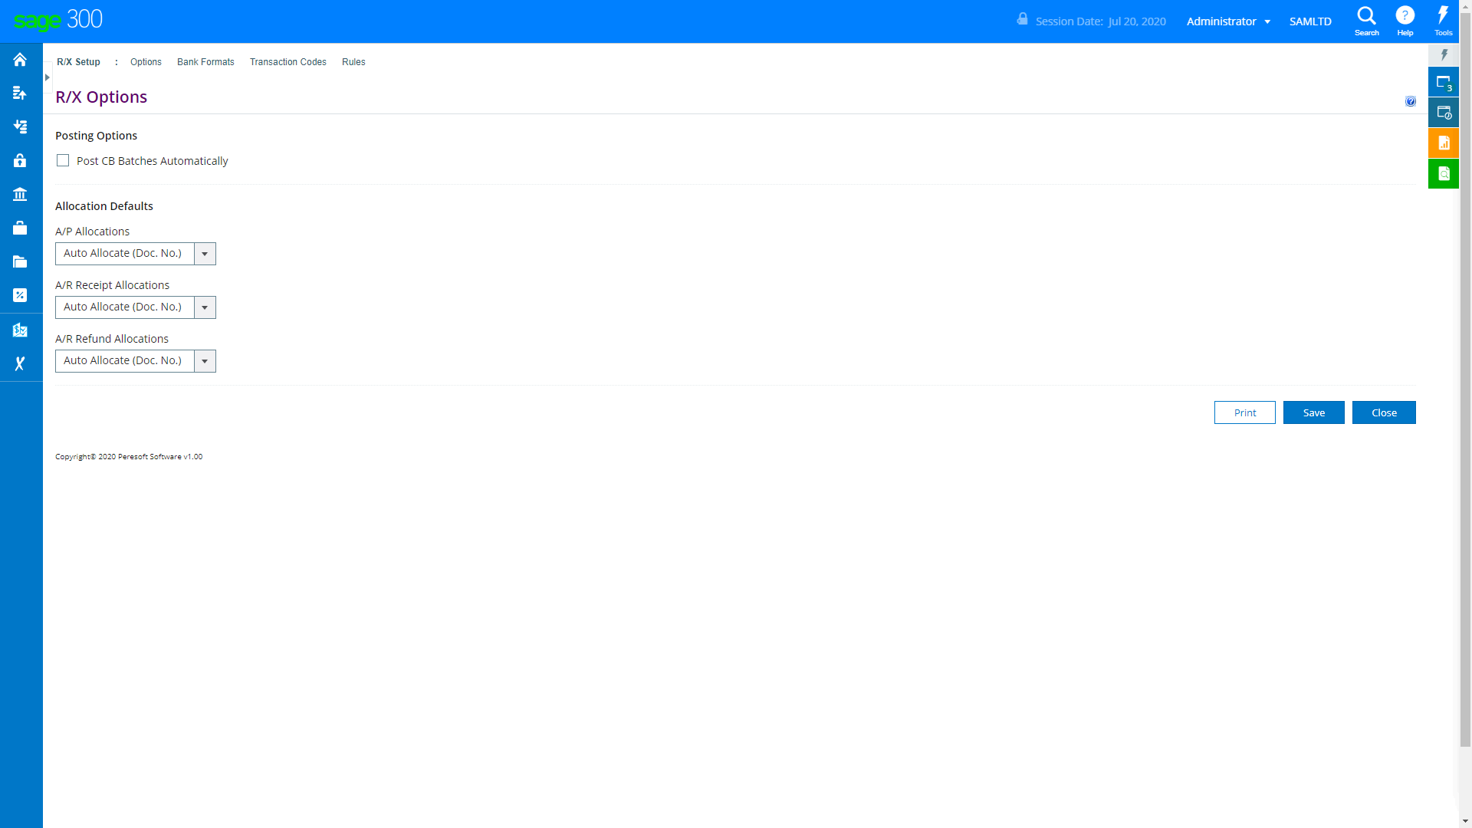
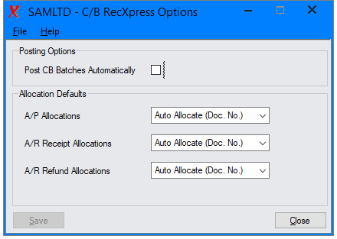

Slide 48
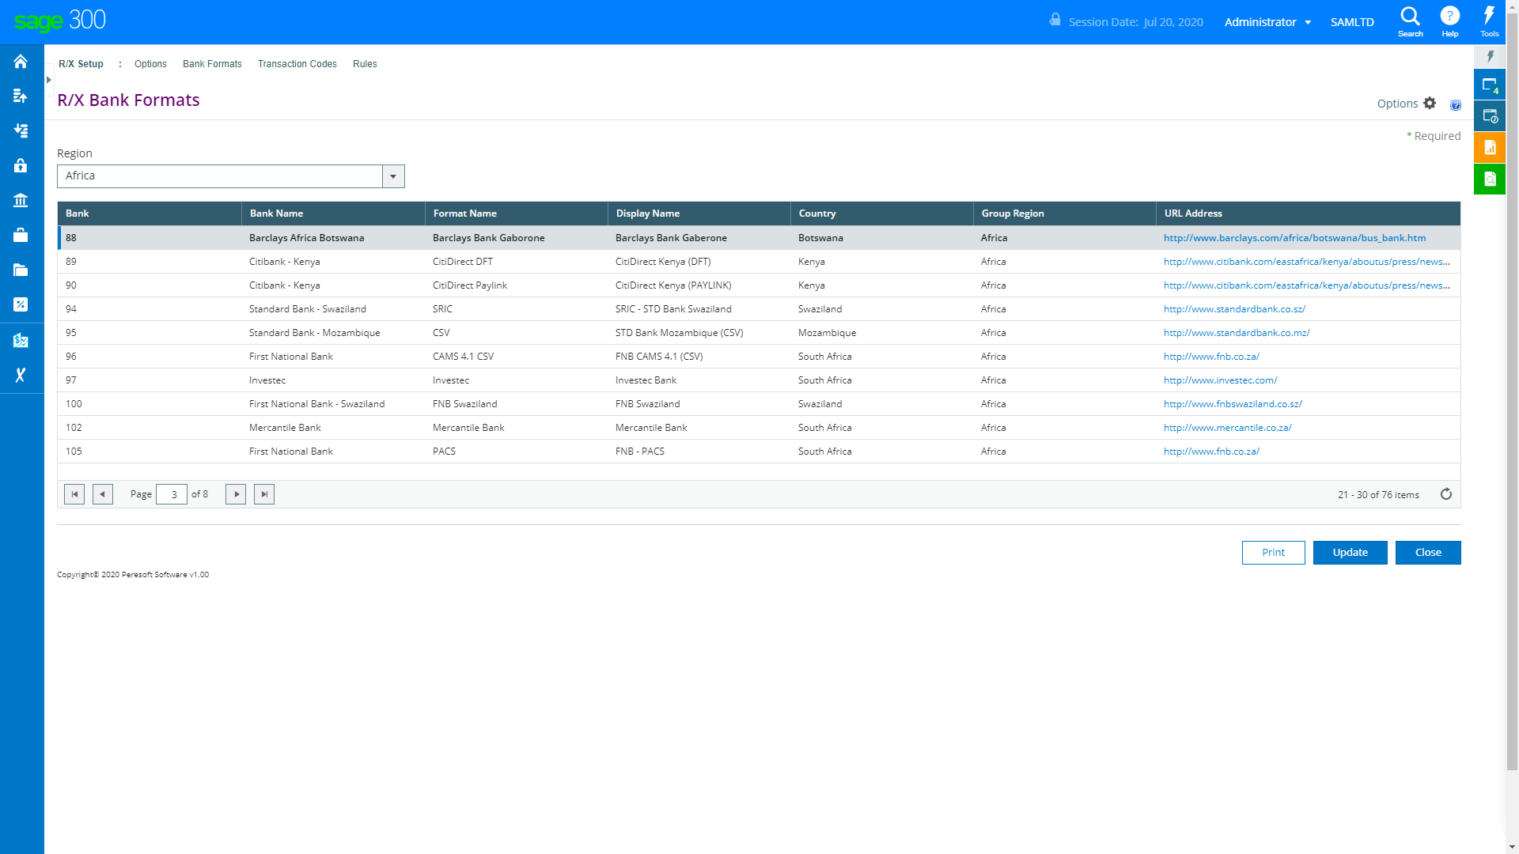

Slide 49
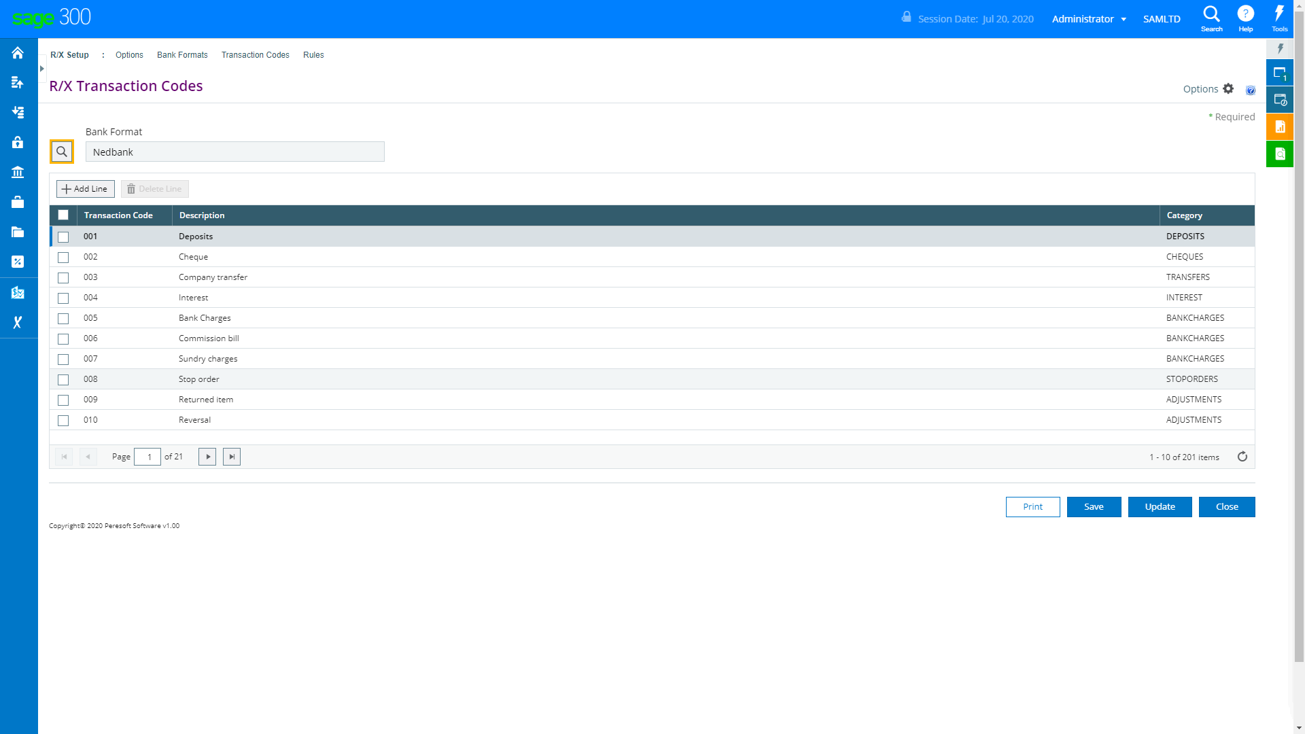

Slide 50


Slide 51




Slide 52



Slide 54


